Slide 1
Epigenetic differences between CD8 populations in T1D patients
5-23-24 SI meeting
Ty Bottorff – Bioinformatics postdoc
Linsley lab
Notes:
ITN ATAC study - Better defining T_{ex} in teplizumab-treated subjects to inform combination treatments
Teplizumab: humanized anti-CD3 monoclonal Ab to delay onset of stage 3 T1D in people with stage 2 T1D. mechanism: weak agonist of TCR-CD3 to induce anergy/apoptosis of T cells (i.e. autoreactive Teffs I presume)
ATACseq relies on transposase that cuts and adds seq adaptors, prefers accessible chromatin

Slide 2
Outline
Background on T_{ex} and T1D
Brief QC
Preliminary results

Slide 3
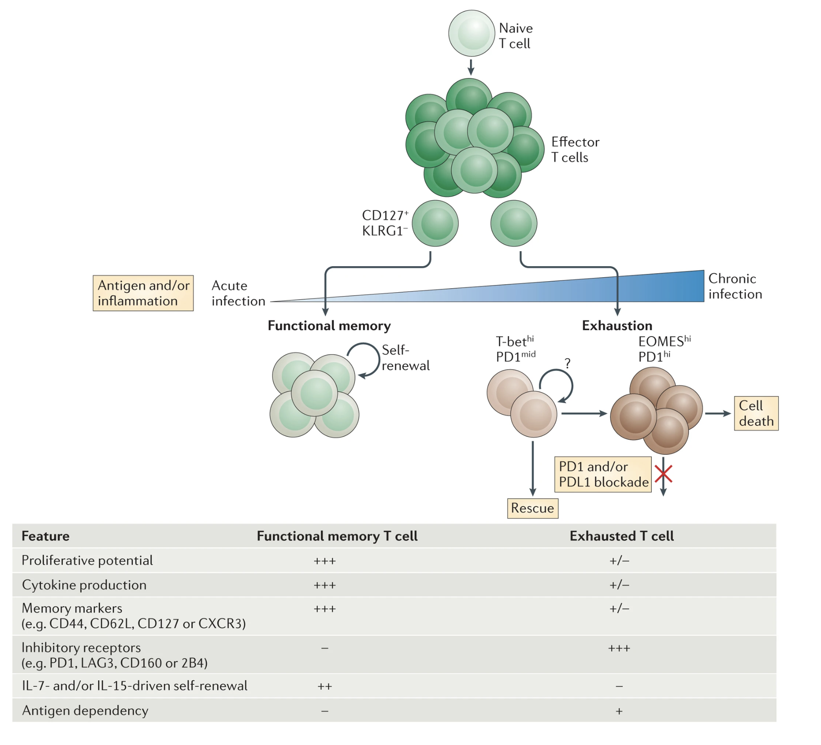
T cell exhaustion results from chronic antigen stimulation, inability to fully clear antigen
Specific TFs (EOMES, TOX) expressed as well
Wherry & Kurachi. Nat Reviews Immunol. 2015
Notes:
Autoimmunity still results likely because affinity between antigens and TCRs are low, so T cells don’t become overly exhausted (i.e. higher affinity TCR-neoantigens more strongly stimulate T cells and exhausts them)
With weakly stimulated but chronic antigens, T cells don’t exhaust (i.e. autoimmunity)
So in case of autoimmunity this is great, in case of cancer it associates with worse response
3 signal model for exhaustion: persistent antigen exposure, negative costimulatory signals, chronic inflammation
Evolutionary reason for Tex could be to minimize self-tissue damage with still controlling antigen somewhat
More and more exhaustion leads to terminal exhaustion & apoptosis

Slide 4
Levels of T_{ex} are a biomarker in T1D
Higher levels of (partial) T_{ex} (TIGIT⁺ KLRG1⁺) CD8s associated with
slower progression to T1D
teplizumab and alefacept responses
beneficial response to therapy in at risk for and new onset T1D
Higher levels of TIGIT⁺KLRG1⁺CD127⁺ CD8s associated with worse outcome
Phenotype of islet-reactive CD8s is more so T_{eff}, less so T_{ex}
Figure 2. Individuals with high levels of different Tex subsets vary in their clinical outcomes after teplizumab treatment. We stratified teplizumab- treated (Active) subjects from the TN-10 study having high (above third quartile) or low (below third quartile) levels of the indicated Tex subsets at 3 months post-treatment. We then used Kaplan-Meier survival analysis to compare time to T1D progression for these groups. As a negative control, we used as placebo- treated subjects.
Notes:
TIGIT⁺KLRG1⁺ Tex cells here are only partially exhausted (addition of TIGIT ligand further downregulates their activity), and there are more exhaustion markers possibly not + here in T+K+
Teplizumab: first FDA approved therapeutic for T1D therapy!
Teplizumab: humanized anti-CD3 monoclonal Ab to delay onset of stage 3 T1D in people with stage 2 T1D. mechanism: weak agonist of TCR-CD3 to induce anergy/apoptosis of T cells (i.e. autoreactive Teffs I presume)
TEX are heterogeneous, with some TEX associating with better or worse outcome in cancer/chronic infection! So not always positive correlation b/w Tex and intensity of autoimmunity, namely DP CD127+ goes against general DP trend

Slide 5
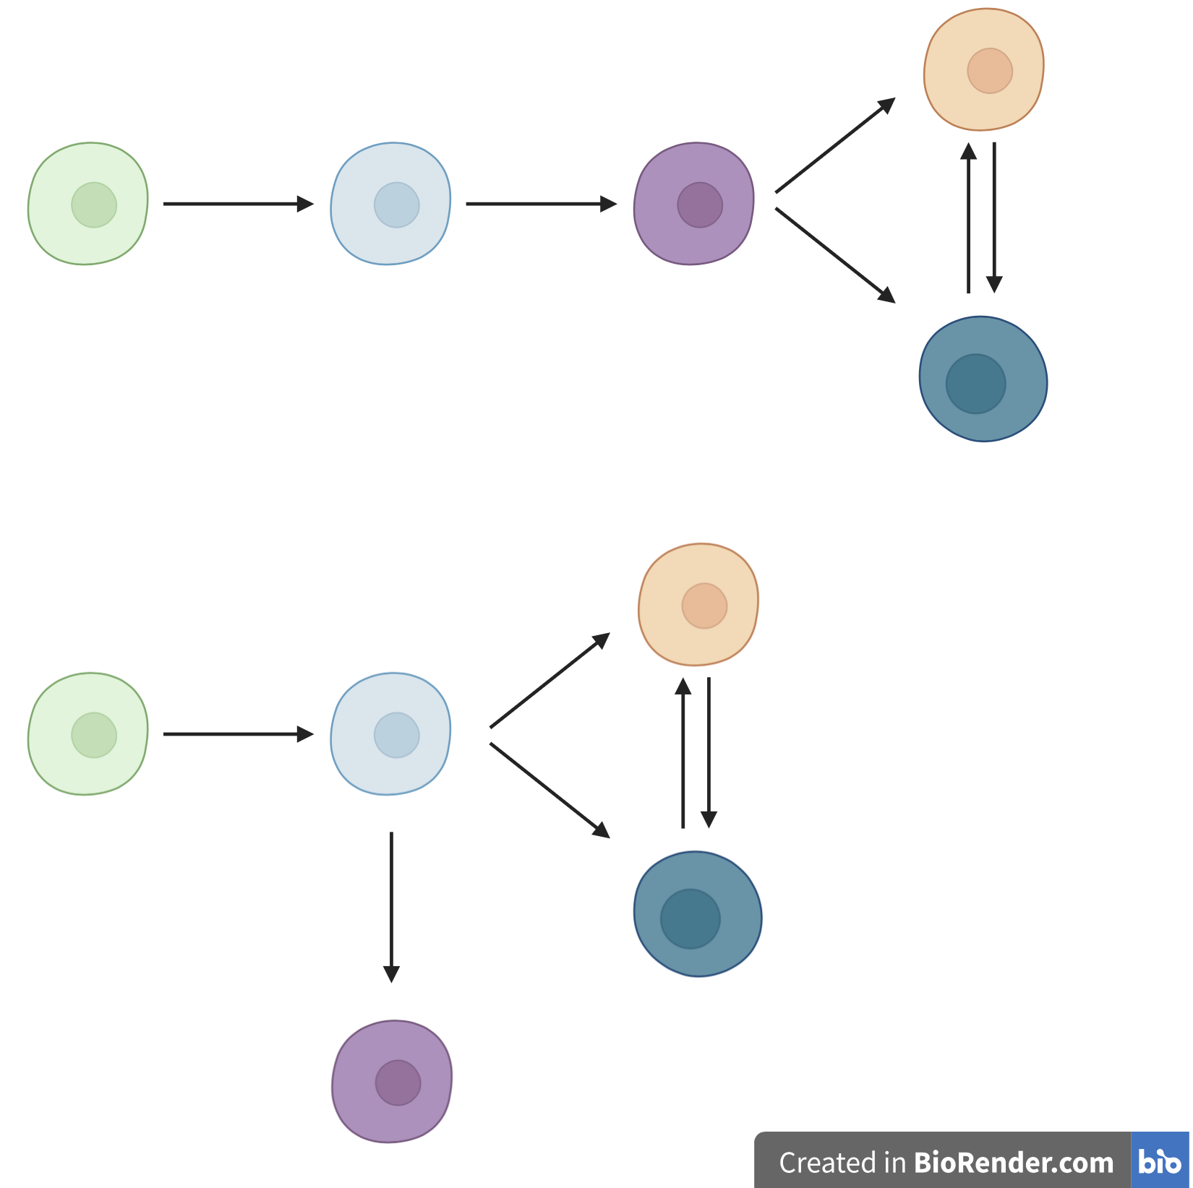
Central questions
Do the epigenetic profiles of responders and non-responders to teplizumab differ?
How do the different cell populations’ epigenetic profiles differ?
are PD-1⁺ and CD57⁺ T_{ex} epigenetically exhausted yet distinct here in teplizumab-treated subjects as observed with alefacept in TIDAL (Witkop, Commun Biol)?
What insights can we gain into CD8 TEM differentiation paths?
CD8 TEM differentiation models
DP PD-1⁺
DP
CD127⁺
TIGIT⁻
KLRG1⁻
TIGIT⁺
KLRG1⁺ (DP)
DP CD57⁺
Notes:
CD8⁺ T cell exhaustion is associated with extensive changes in accessible chromatin, so let’s do ATACseq here, also cellular differentiation and lineage commitment are often mediated by epigenetic mechanisms, ie motivation for doing ATACseq here
Teplizumab: humanized anti-CD3 monoclonal Ab to delay onset of stage 3 T1D in people with stage 2 T1D. mechanism: weak agonist of TCR-CD3 to induce anergy/apoptosis of T cells (i.e. autoreactive Teffs I presume)
Separate lineages is an oversimplification, likely overlapping populations (this is what we mean by heterogeneity)
PD1 and CD57 Tex are both hypo-proliferative and express IR in T1DAL study (alefacept), TCR junction sequence identity between CD57+ and PD-1+ Tex, suggesting shared clonal relationships (fluid, bidirectional) in Erin’s analyses
Both PD1+ and CD57+ Tex subsets share phenotypic (hypoproliferation, IR expression) and epigenetic signatures of Tex, with CD57 Tex having more open chromatin in lytic and KIR regulatory genes (Witkop, Commun Biol in revision)
CD57⁺ (also high for NK associated genes), marker of cytotoxic function
PD1 is an IR/activation marker
Point #2: i.e. are some more Tex?
Motivation for point 3:
PD-1+ associated with better outcome?
CD127+ associated with worse outcome
T1DAL: alefacept (LFA3-Ig fusion, binds CD2, disrupts CD58-mediated costimulation of T cells, selectively depletes memory/effector T cells)
CD2 costimulation can prevent exhaustion, alefacept (anti-CD2) can help treat T1D i.e. by allowing exhaustion presumably
Epigenetic analysis of PD-1⁺ Tex subset may inform clinical trial design with PD-1 agonism
Blocking IL7R seems to protect against T1D, so CD127+ is associated with worse T1D prognosis
Biorender is simplification of overlapping cell pops
TIGIT: IR, a negative signal increased following T cell activation, associated with exhaustion, CD155 is ligand
KLRG1: inhibitory, also cytotoxic marker
PD-1: IR, a negative signal increased following T cell activation
CD57: cytotoxicity
CD127: inflammatory marker

Slide 6
Different differentiation models have implications for effects of blocking CD127⁺ lineage
CD8 TEM differentiation models
DP PD-1⁺
DP
CD127⁺
X
TIGIT⁻
KLRG1⁻
TIGIT⁺
KLRG1⁺ (DP)
DP CD57⁺
X

Slide 7
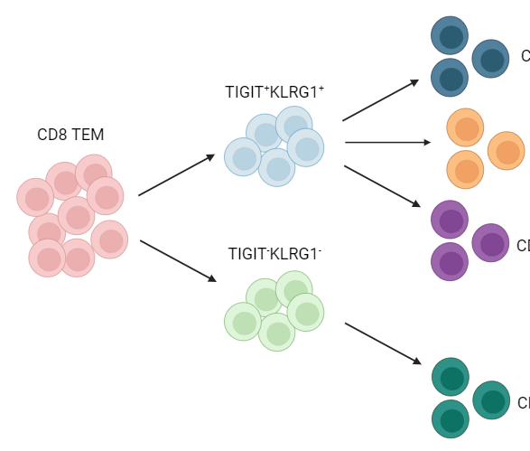
Study design
bulk ATAC-seq of 5 populations (bolded)
TIGIT⁺
KLRG1⁺ (DP)
DP CD57⁺
not-naive
CD8s
DP PD1⁺
AbATE (teplizumab) subjects
DP CD127⁺
TIGIT⁻KLRG1⁻ (DN)
non-exhausted (not DP) CD127⁺
6 responders, TIGIT⁺KLRG1⁺ high
sort
4 non-responders, TIGIT⁺KLRG1⁺ low
CyTOF
Notes:
16 samples from anti-CD3 (AbATE) treated T1D, peak of response
Estimated cell yields (30K sorted cells for bulk ATAC)
Responder = <40% decline in C-peptide AUC in two years
Teplizumab: humanized anti-CD3 monoclonal Ab to delay onset of stage 3 T1D in people with stage 2 T1D. mechanism: weak agonist of TCR-CD3 to induce anergy/apoptosis of T cells (i.e. autoreactive Teffs I presume)
KLRG1: co-inhibitory receptor belonging to inhibitory killer cell lectin-like receptors on NK cells and antigen-experienced human T cells, thought to be a senescent marker for human T cells with poor proliferation and impaired clonal expansion after stimulation
CD127 = IL7R

Slide 8
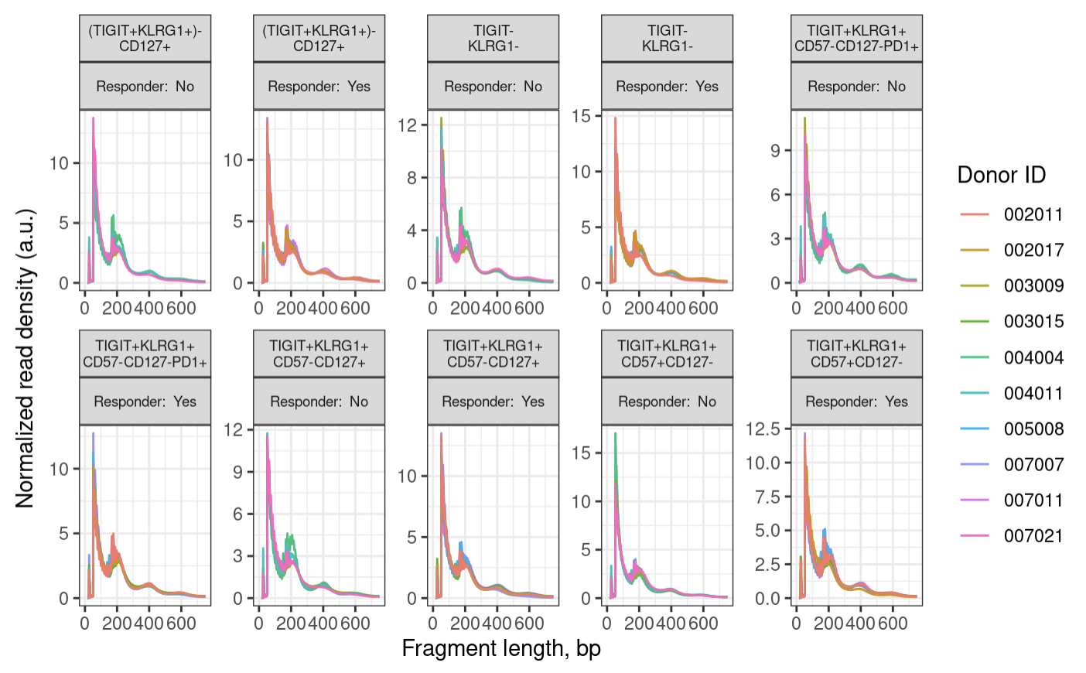
Fragment size distributions pass QC
Non-exhausted CD127⁺
Non-exhausted CD127⁺
DN
DN
DP PD-1⁺
DP PD-1⁺
DP CD127⁺
DP CD127⁺
DP CD57⁺
DP CD57⁺
Notes:
100 bp peak, 200, 400 bp oscillations
expect a peak around 100 bp (nuclesome free region) and then oscillations with maxima 200 bp mono-nucleosome, 400 bp di-nucleosome and so on
wiggles in the below plot are a biological feature and come from 10 bp per helical turn of the DNA
200 is like 2 100s together due to a nucleosome b/w preventing cut

Slide 9
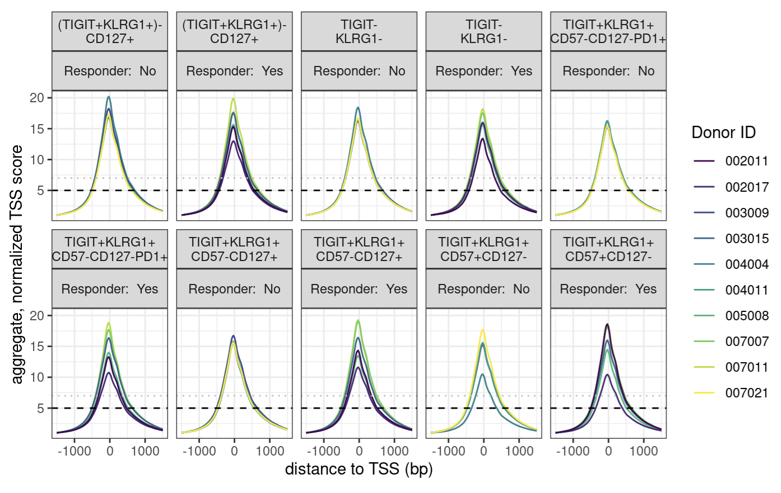
Enrichment over the TSS passes QC
Non-exhausted CD127⁺
Non-exhausted CD127⁺
DN
DN
DP PD-1⁺
DP PD-1⁺
DP CD127⁺
DP CD127⁺
DP CD57⁺
DP CD57⁺
Notes:
enrichment over TSS, signal:noise
we are looking for > 7, while 5-7 is still acceptable

Slide 10
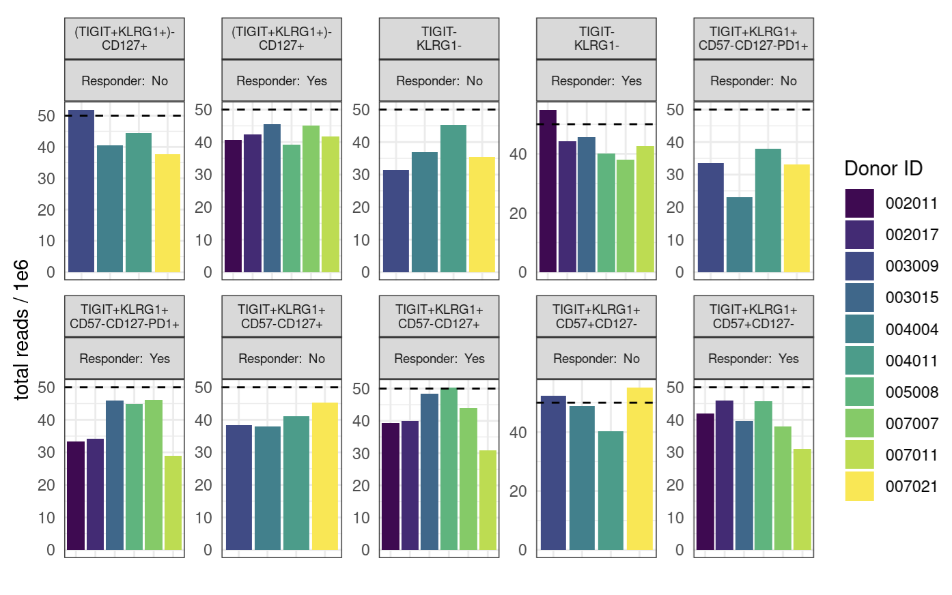
Few libraries have desired 50 million reads
Non-exhausted CD127⁺
Non-exhausted CD127⁺
DN
DN
DP PD-1⁺
DP PD-1⁺
DP CD127⁺
DP CD127⁺
DP CD57⁺
DP CD57⁺
Notes:
ENCODE recommends 50 mio (aligned) reads for paired-end, 25 mio for single read
ENCODE: each replicate should have 25 million non-duplicate, non-mitochondrial aligned reads for single-end sequencing and 50 million for paired-ended sequencing (i.e. 25 million fragments, regardless of sequencing run type). The alignment rate, or percentage of mapped reads, should be greater than 95%, though values > 80% may be acceptable
want 10-50 mil reads depending on if TF analysis required (ENCODE suggestions)
consequences: may have reduced sensitivity (for low abundance/rare stuff), increased noise, decreased reproducibility across replicates (i.e. within sort+responder groups)
P452 may have had more reads/library because less libraries for the flowcell… Vivian expected P576-1 reads average around 50M but they were on average lower…

Slide 11
After QC (all libraries pass)
Merge alignment .bam files by study group (cell sort + responder status)
Call peaks on merged alignment files
Merge peaks to obtain “consensus peaks” (candidate genomic regions with biological relevancy across samples & study groups)
Notes:
Merging alignment bams ~= pile up reads
Steps 1-2 ~ pseudobulking for RNA degs
Consensus = relevant across samples vs. just in 1/few samples
Consensus peaks = candidate regions (binned genome), we need them because we need to be looking at peaks that are relevant across samples vs. peaks just in 1/few samples?
*2-4 are an alternative to default of obtaining consensus peaks by fixed list of 400 bp wide peaks overlapping between > 2 samples (washes out signal)
This approach deals with different peak widths across samples better, obtaining more representative peaks, should be more sensitive

Slide 12
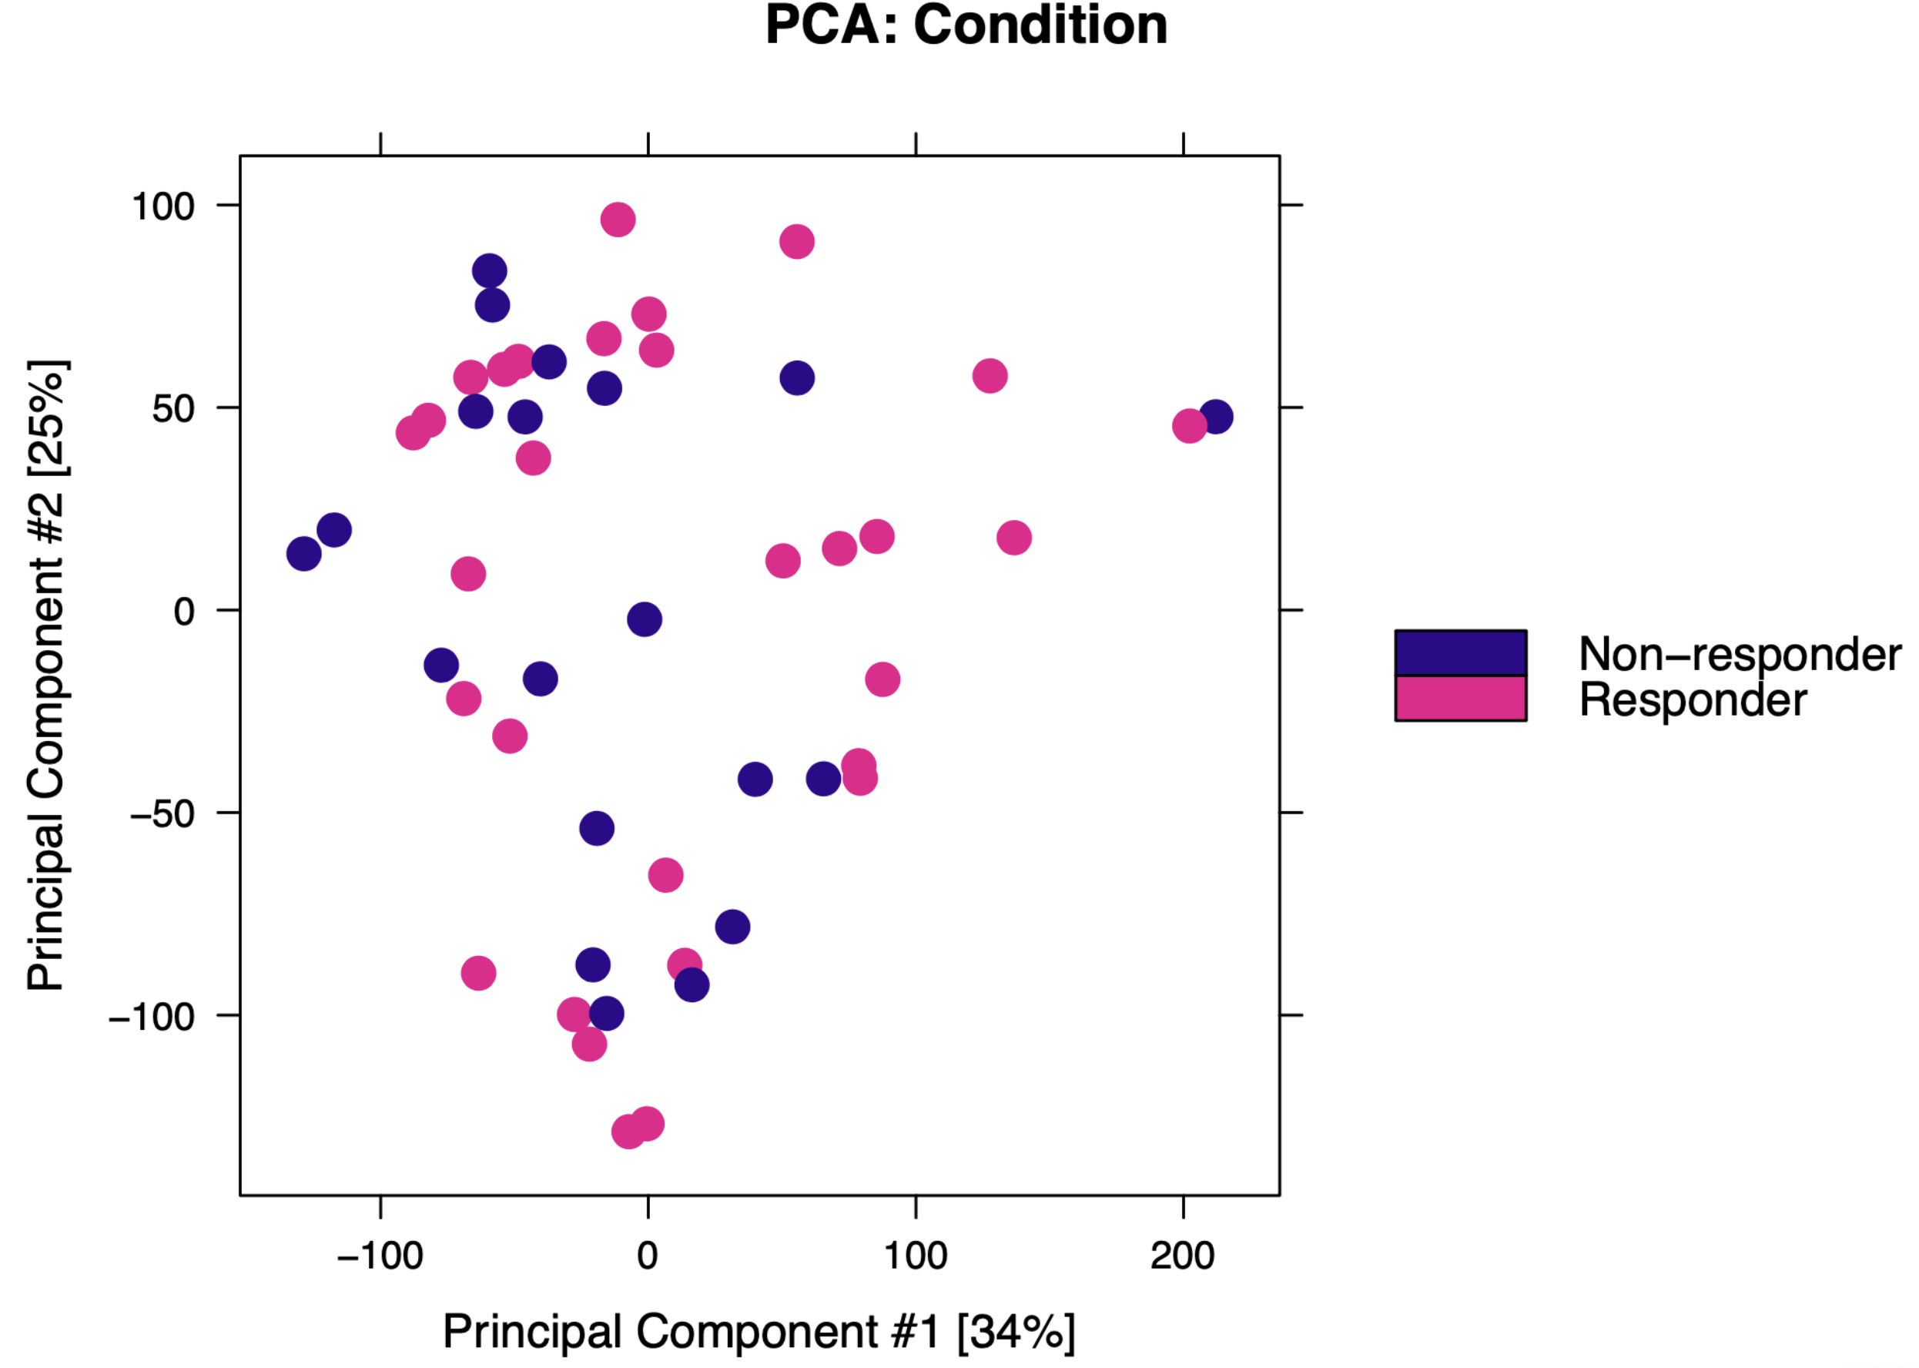
Epigenetic profiles between responders and non-responders are similar
R & NR grouped for all subsequent analyses

Slide 13
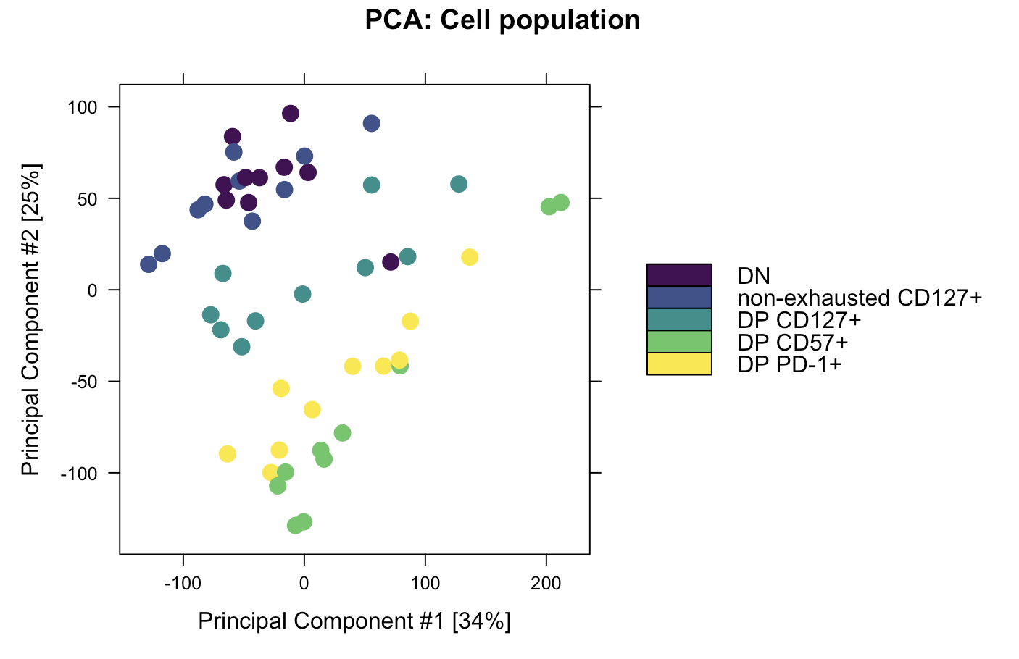
Epigenetic profiles of cell types differ

Slide 14
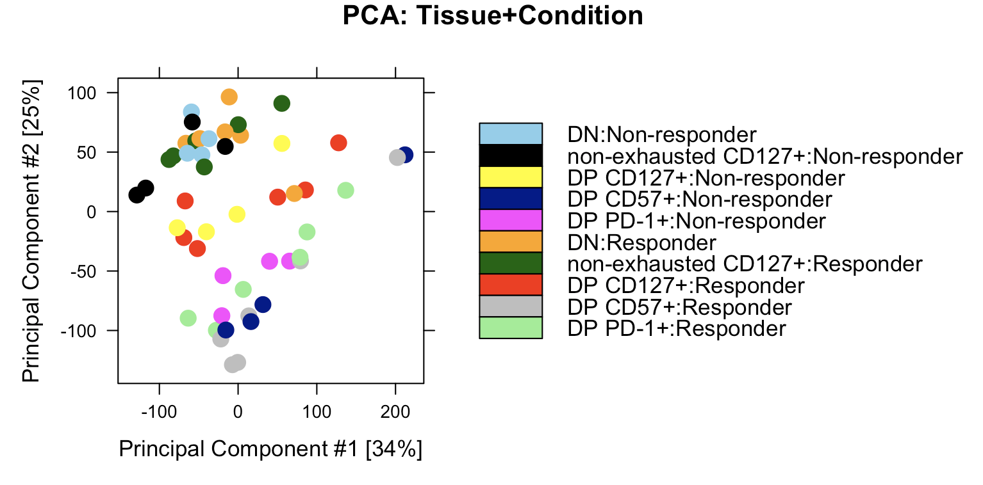
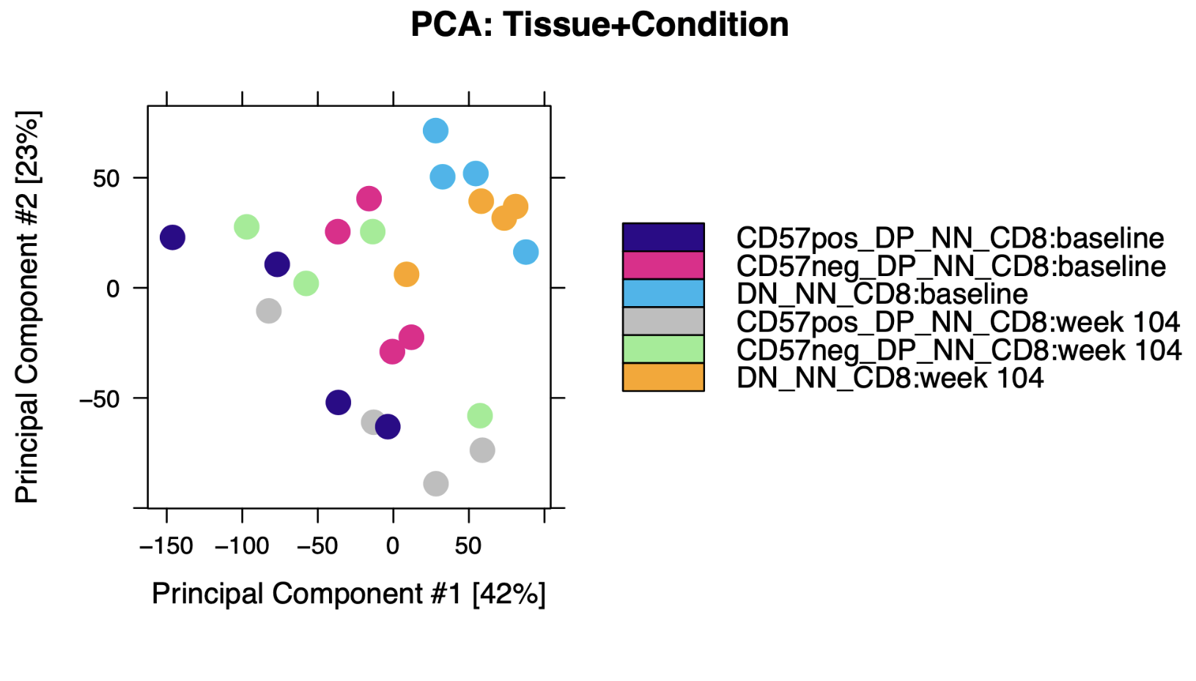
Donor to donor variability is comparable with P452 T1DAL analyses
DP CD57⁺:baseline
DP PD-1⁺: baseline
DN: baseline
DP CD57⁺: week 104
DP PD-1⁺: week 104
DN: week 104
P576
P452

Slide 15
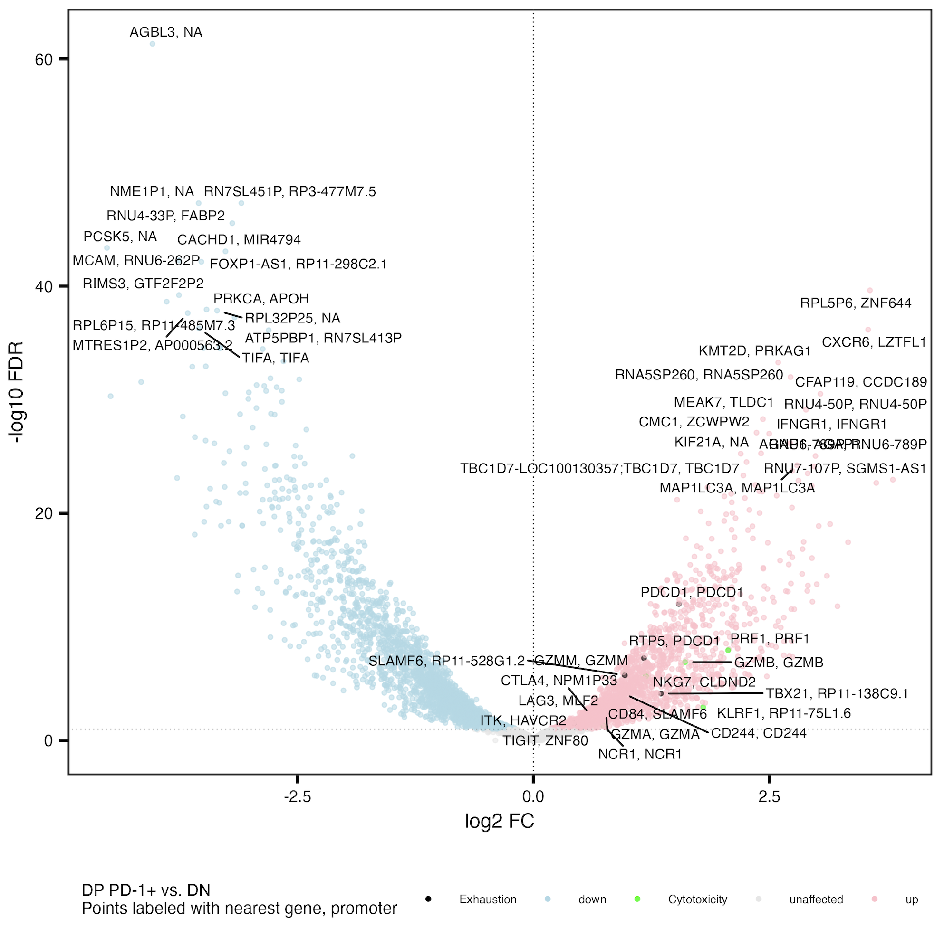
Cytotoxicity and exhaustion peaks’ genes more accessible in DP PD-1⁺ vs. DN
Similar to Erin’s P452 T1DAL analyses
Exhaustion: CD244, SLAMF6, TBX21, PDCD1, HAVCR2, KLRG1, TOX, TCF1, PD1, CTLA4, LAG3, TIM3, TIGIT, KIR3DL2, KIR2DL3, NKG2A
Cytotoxicity: GZMA, GZMB, GZMH, GZMM, GZMK, PRF1, NCR1, KLRF1, NKG7
Notes:
Erin’s PD-1 up vs. DN: GZMB, GZMH, LAG3, TBX21, NKG7, CD244, KLRF1
Cytotoxicity up even though “exhausted” because DP is only partially exhausted? And DN can have other exhaustion markers I suppose

Slide 16
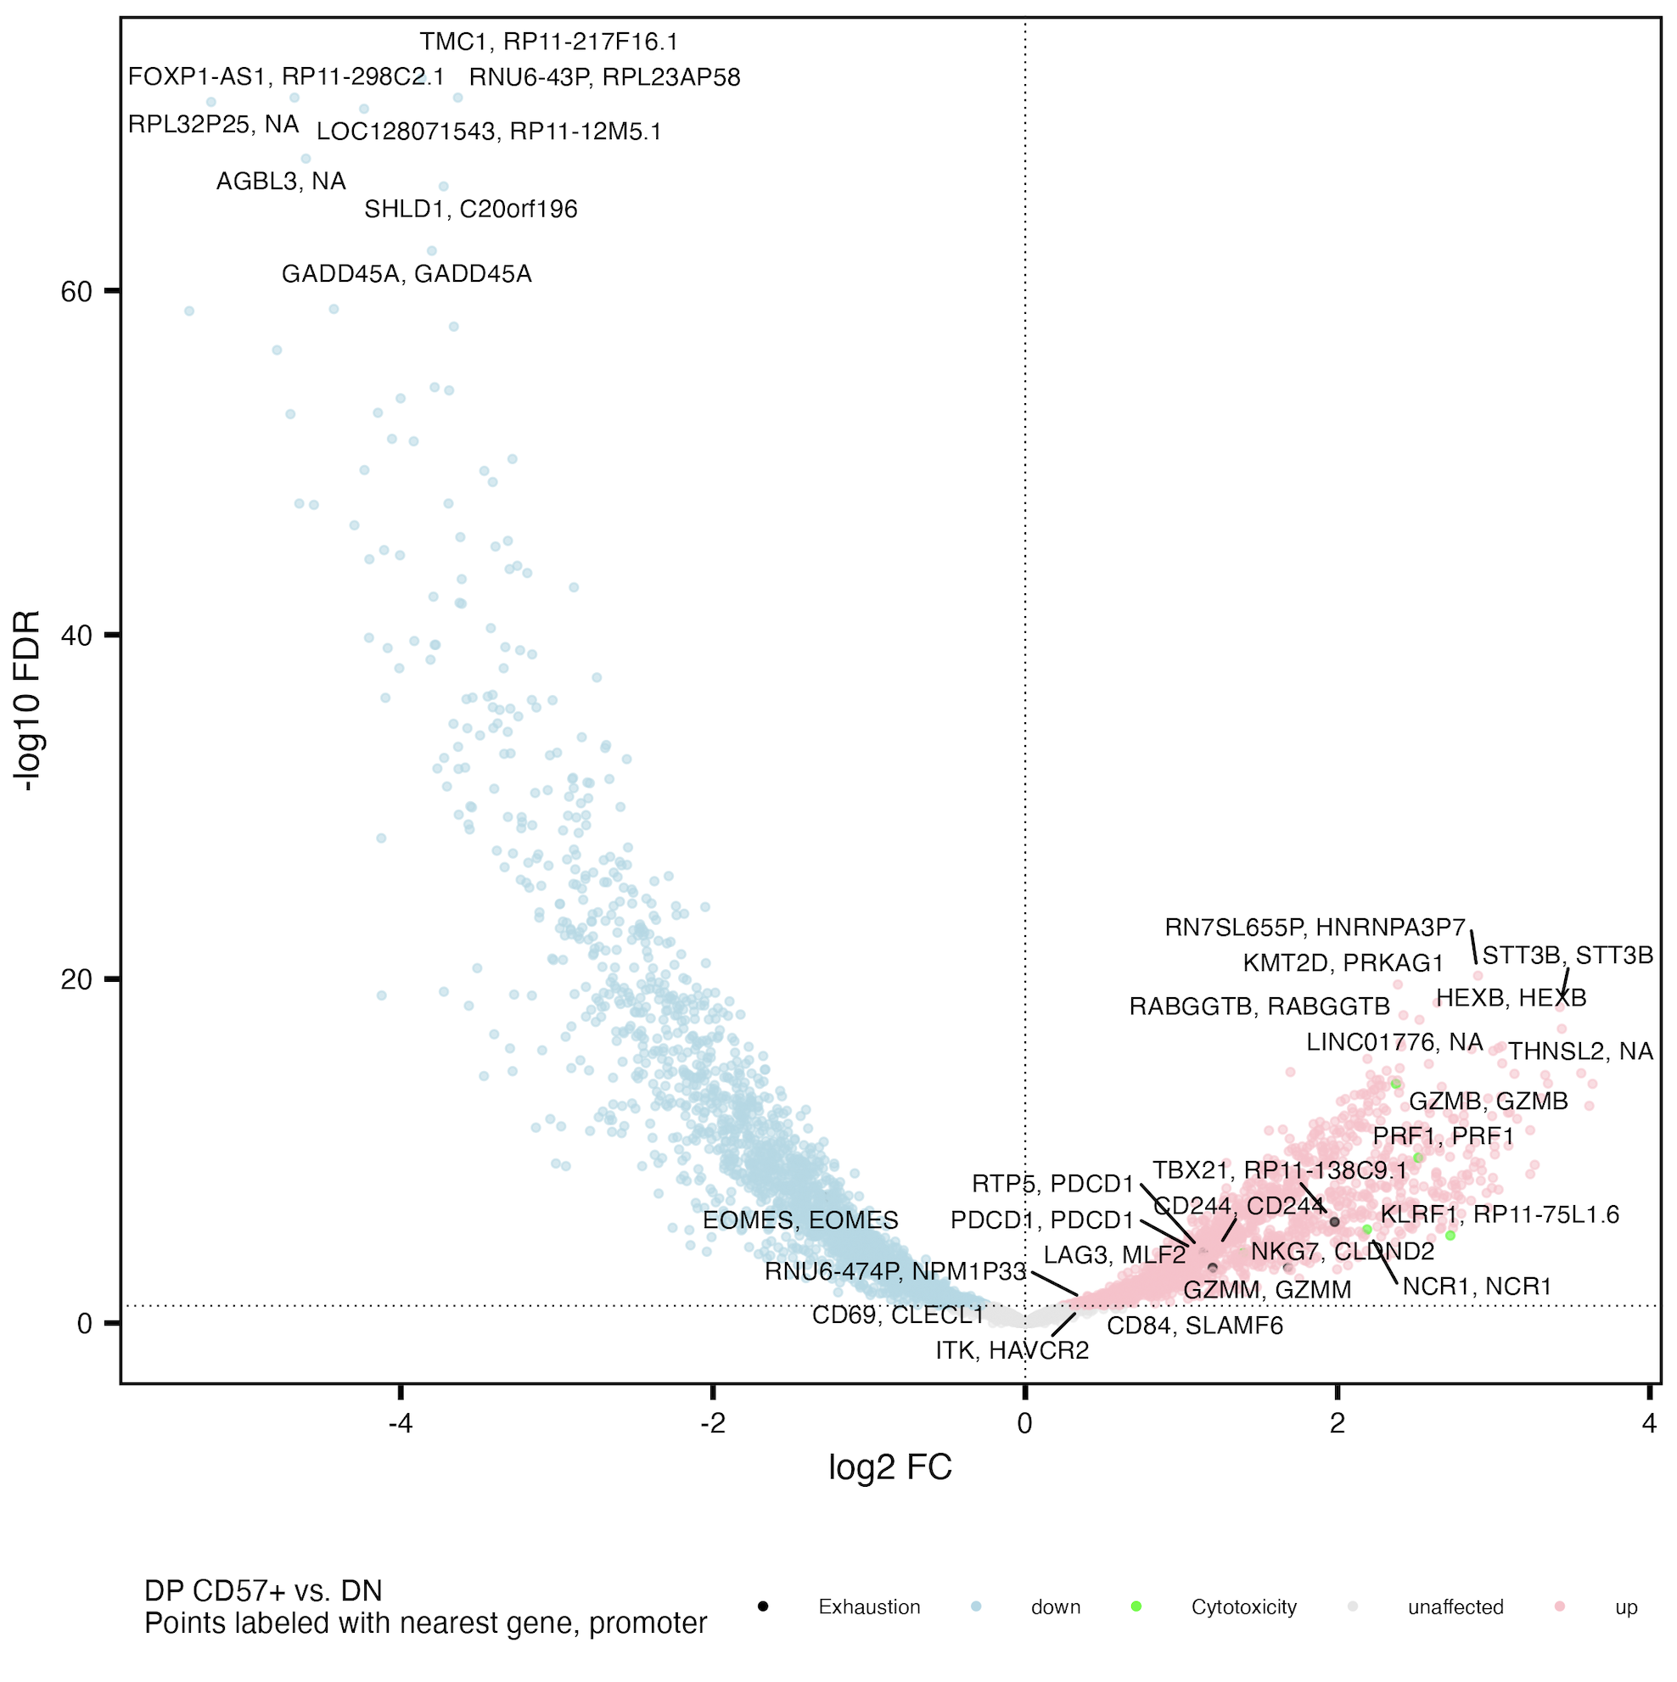
Cytotoxicity and exhaustion peaks’ genes generally more accessible in DP CD57⁺ vs. DN
Similar to Erin’s P452 T1DAL analyses
Exhaustion: CD244, SLAMF6, TBX21, PDCD1, HAVCR2, KLRG1, TOX, TCF1, PD1, CTLA4, LAG3, TIM3, TIGIT, KIR3DL2, KIR2DL3, NKG2A
Cytotoxicity: GZMA, GZMB, GZMH, GZMM, GZMK, PRF1, NCR1, KLRF1, NKG7
Notes:
Erin’s CD57 up vs. DN: GZMB/GZMH, NCR1, KLRF1, CD244, SLAMF6, LAG3, TBX21, PDCD1

Slide 17
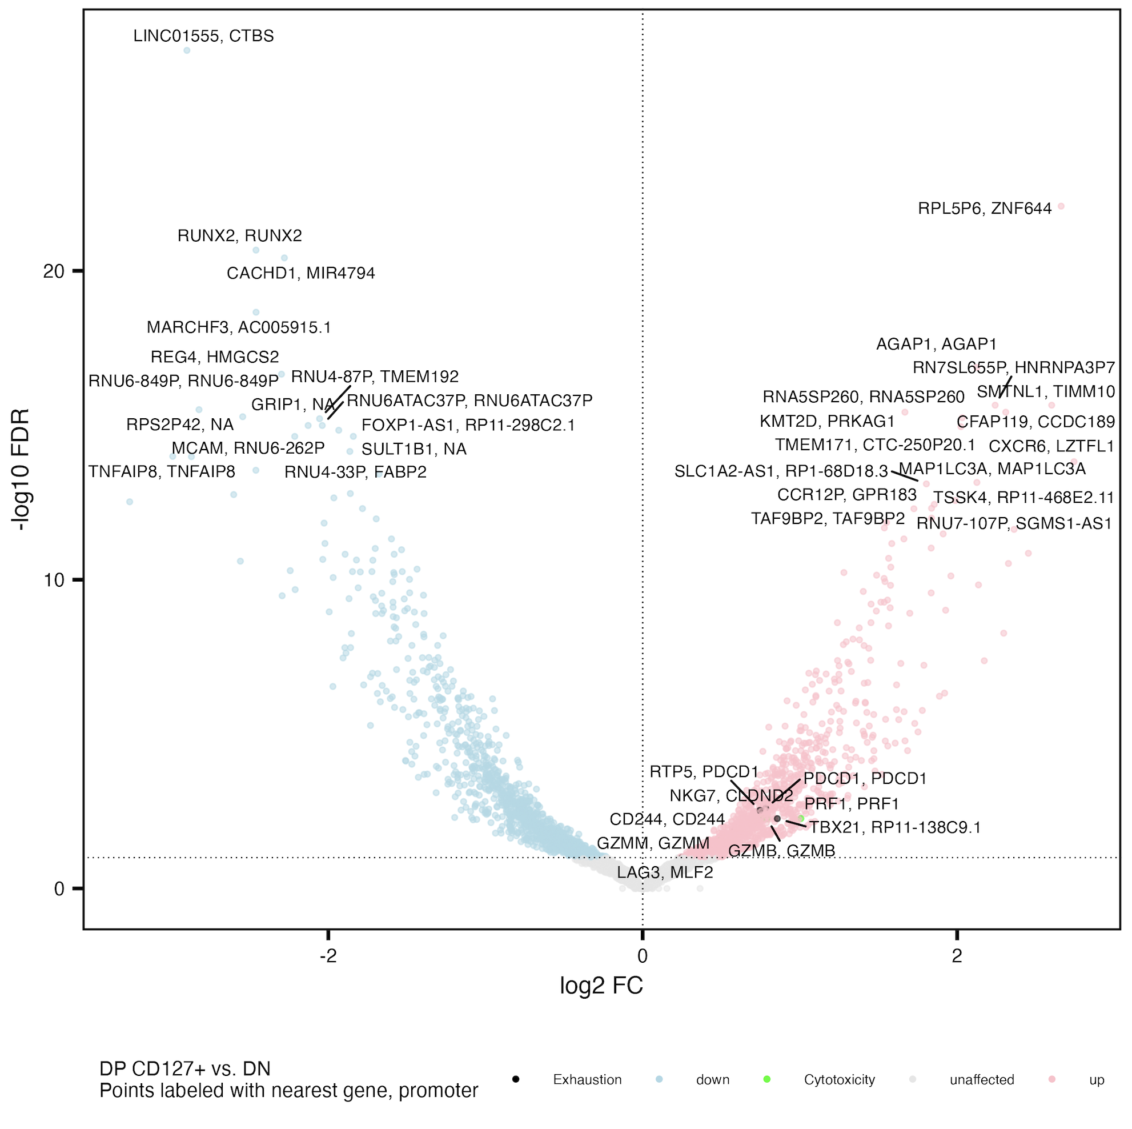
Cytotoxicity and exhaustion peaks’ genes more accessible in DP CD127⁺ vs. DN
Exhaustion: CD244, SLAMF6, TBX21, PDCD1, HAVCR2, KLRG1, TOX, TCF1, PD1, CTLA4, LAG3, TIM3, TIGIT, KIR3DL2, KIR2DL3, NKG2A
Cytotoxicity: GZMA, GZMB, GZMH, GZMM, GZMK, PRF1, NCR1, KLRF1, NKG7

Slide 18
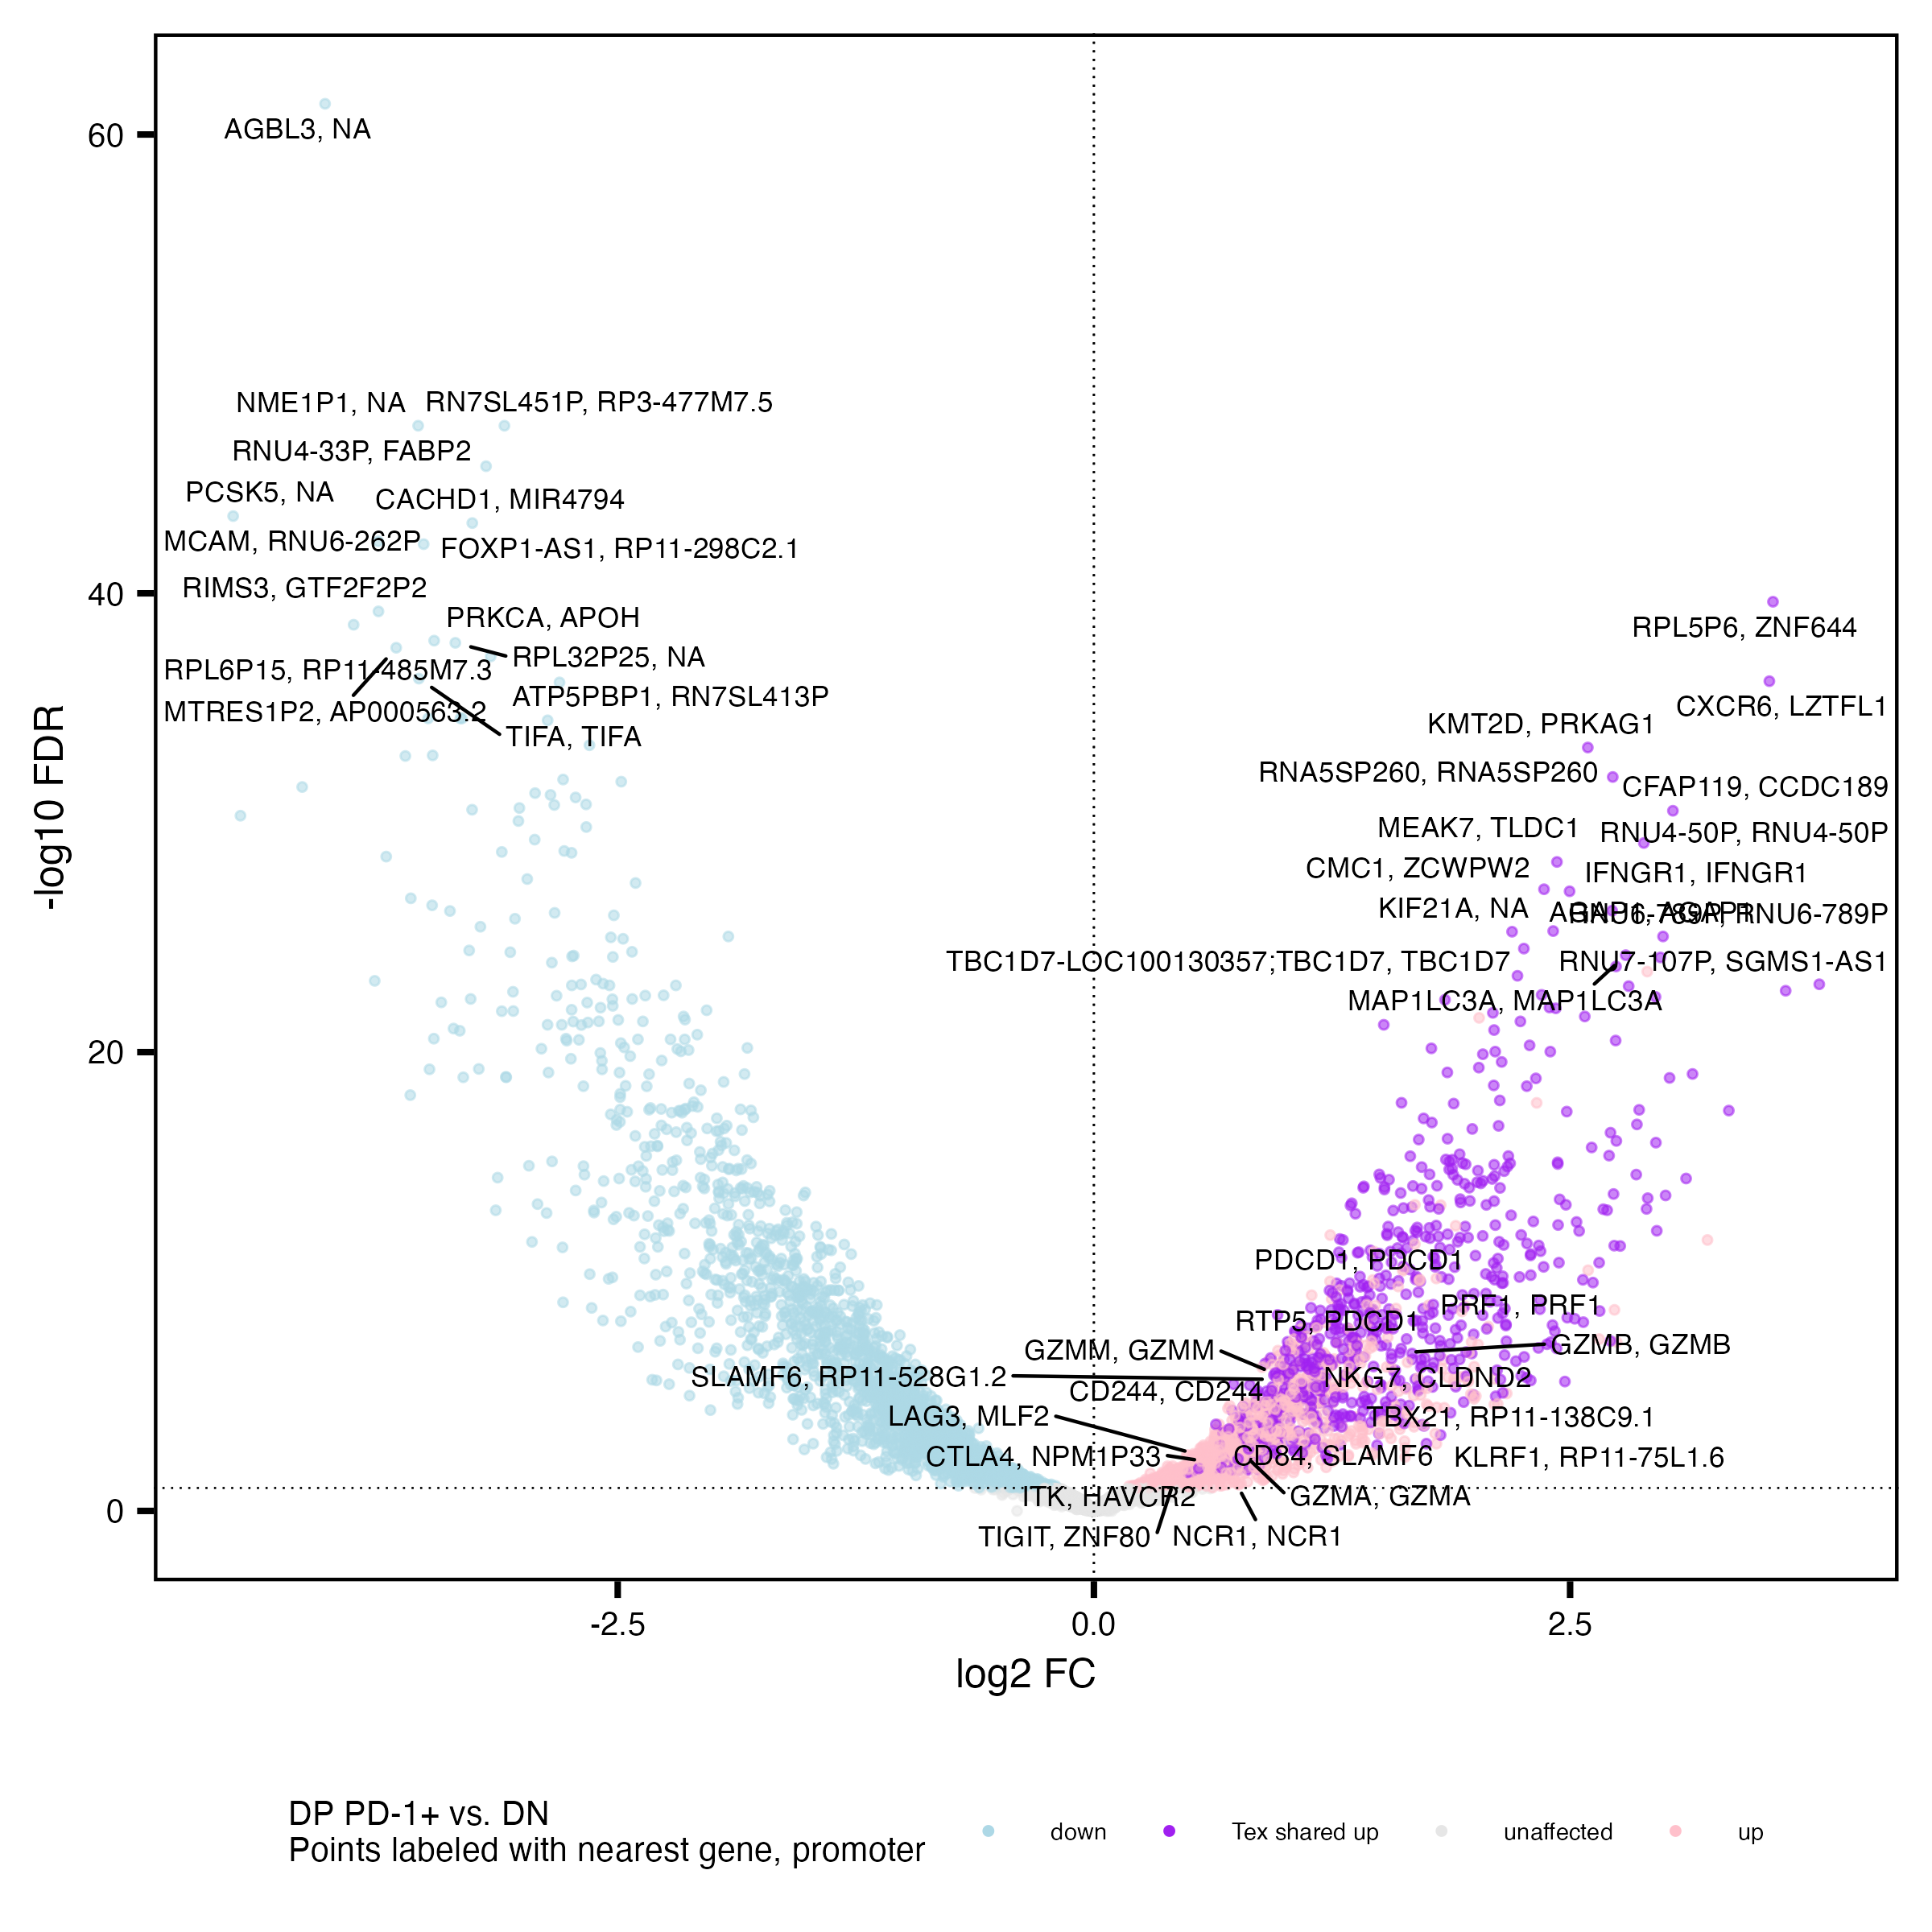
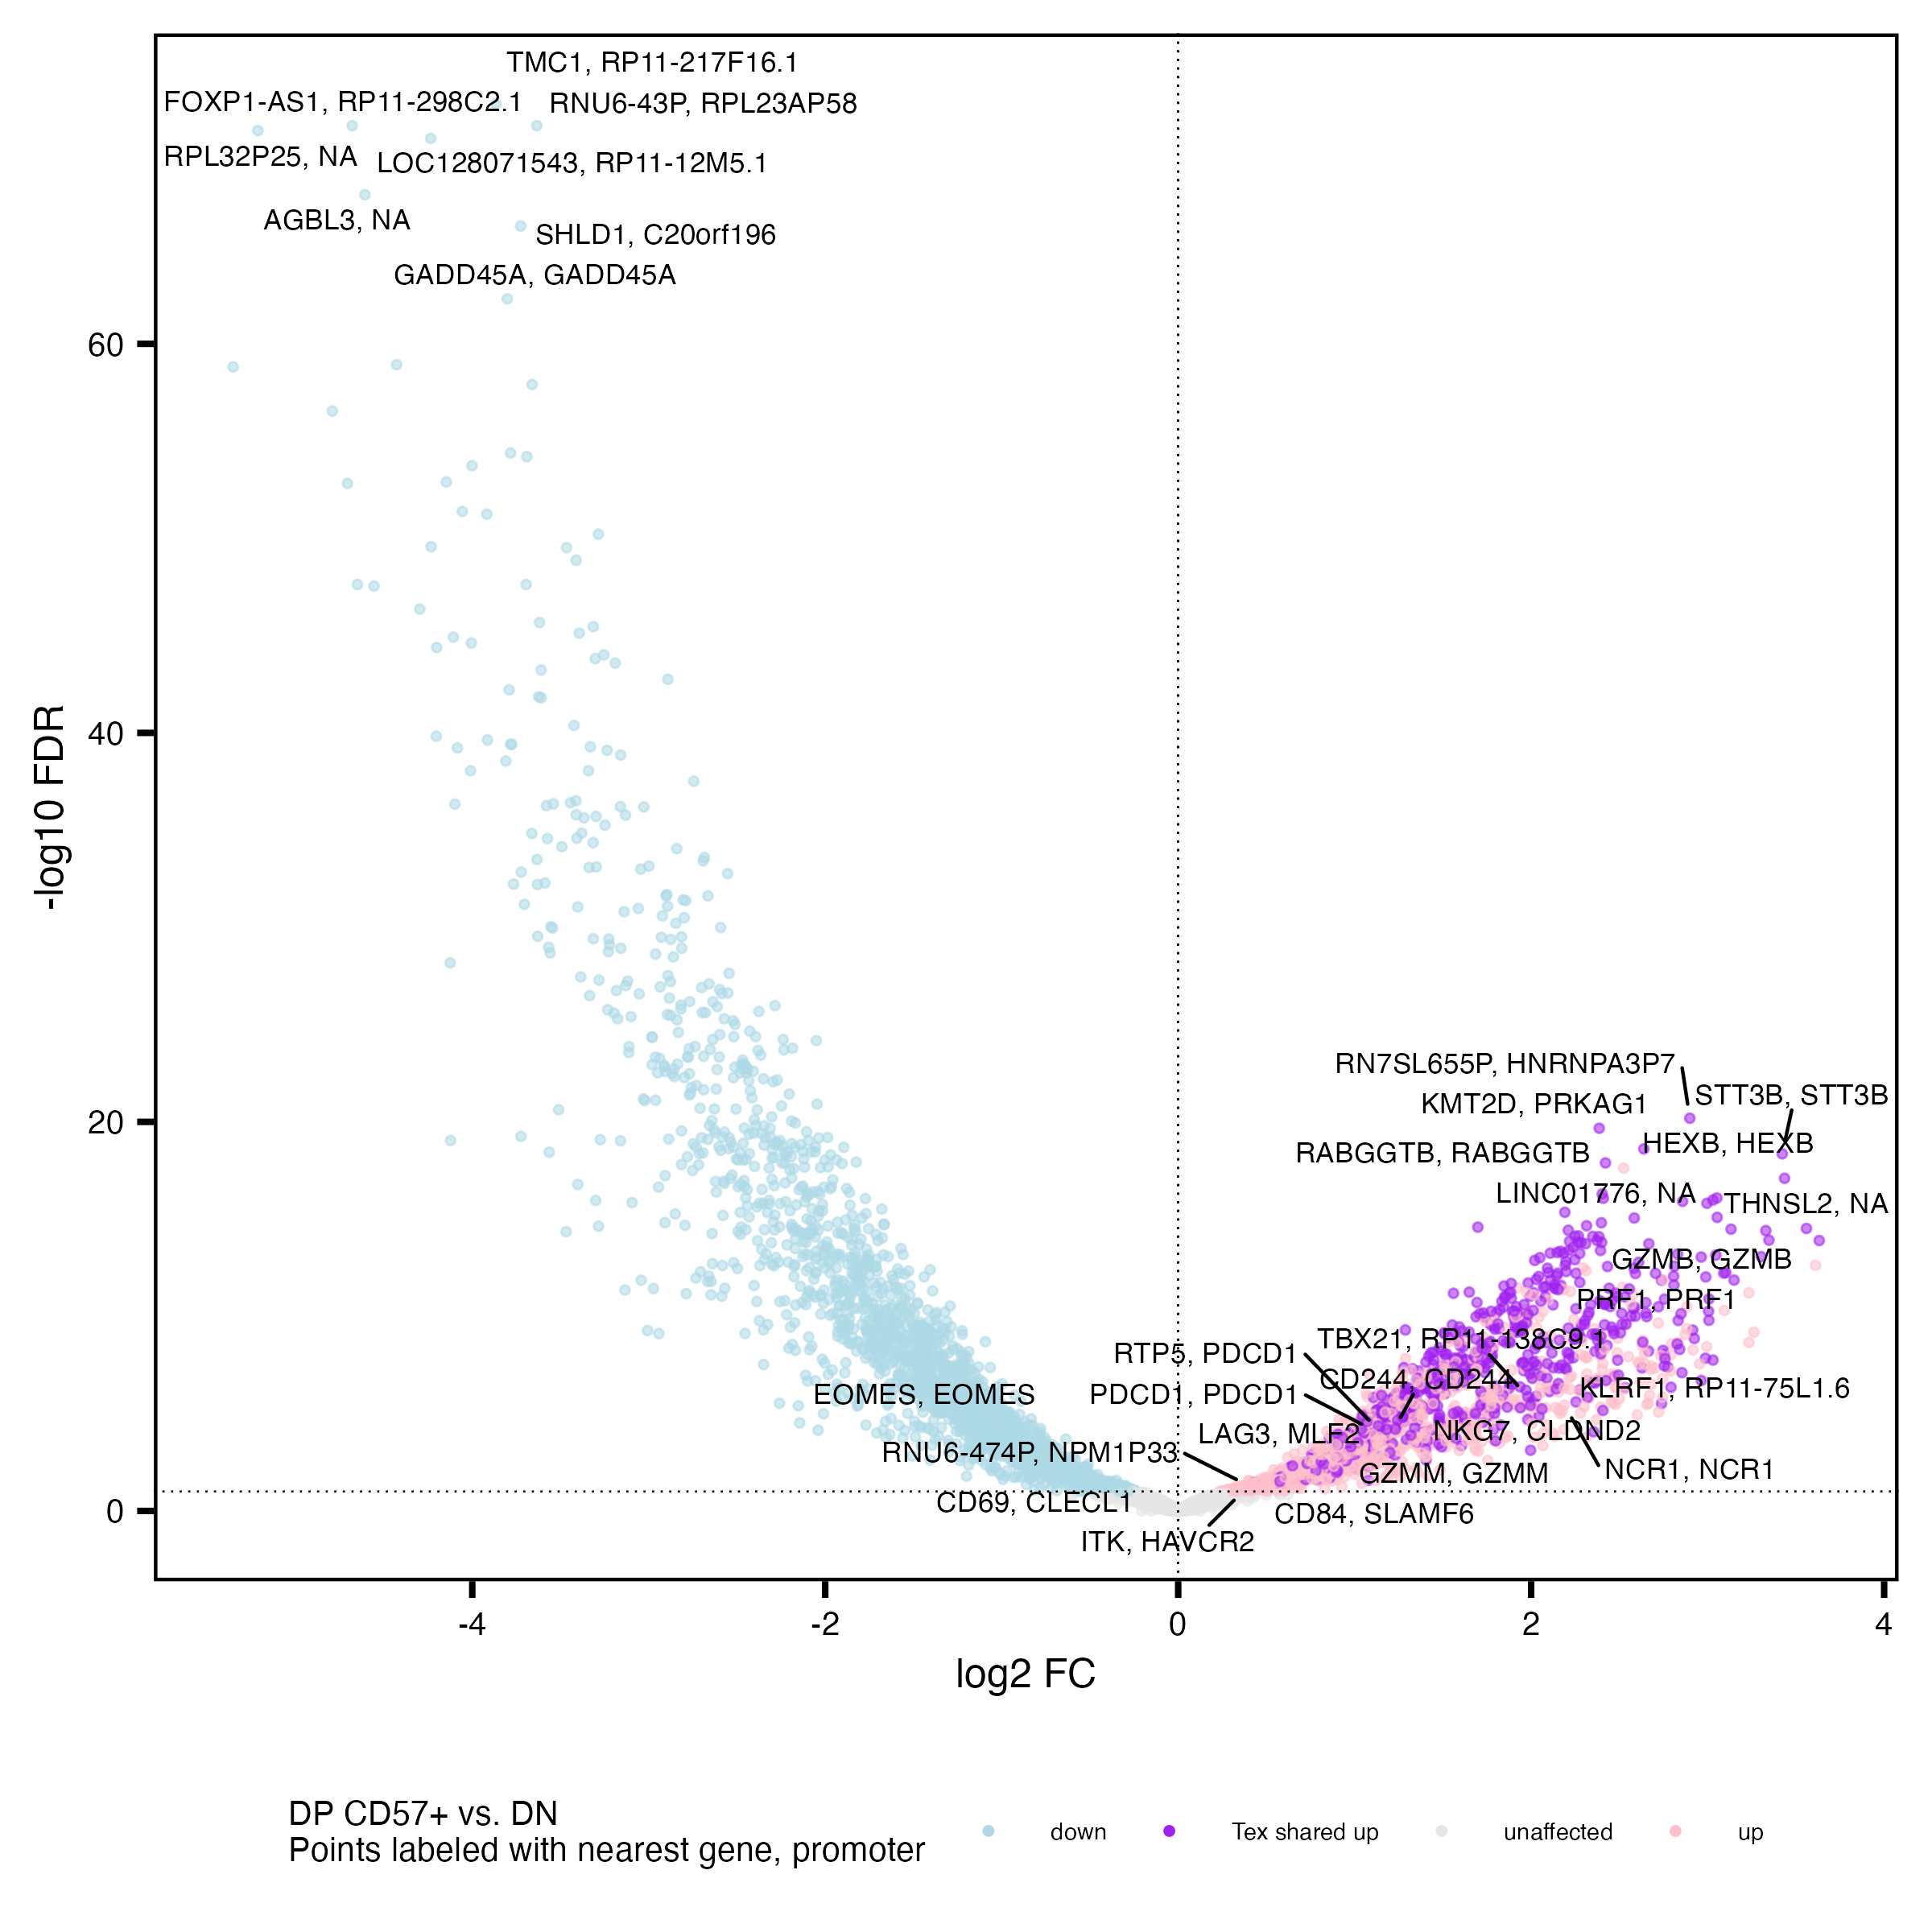
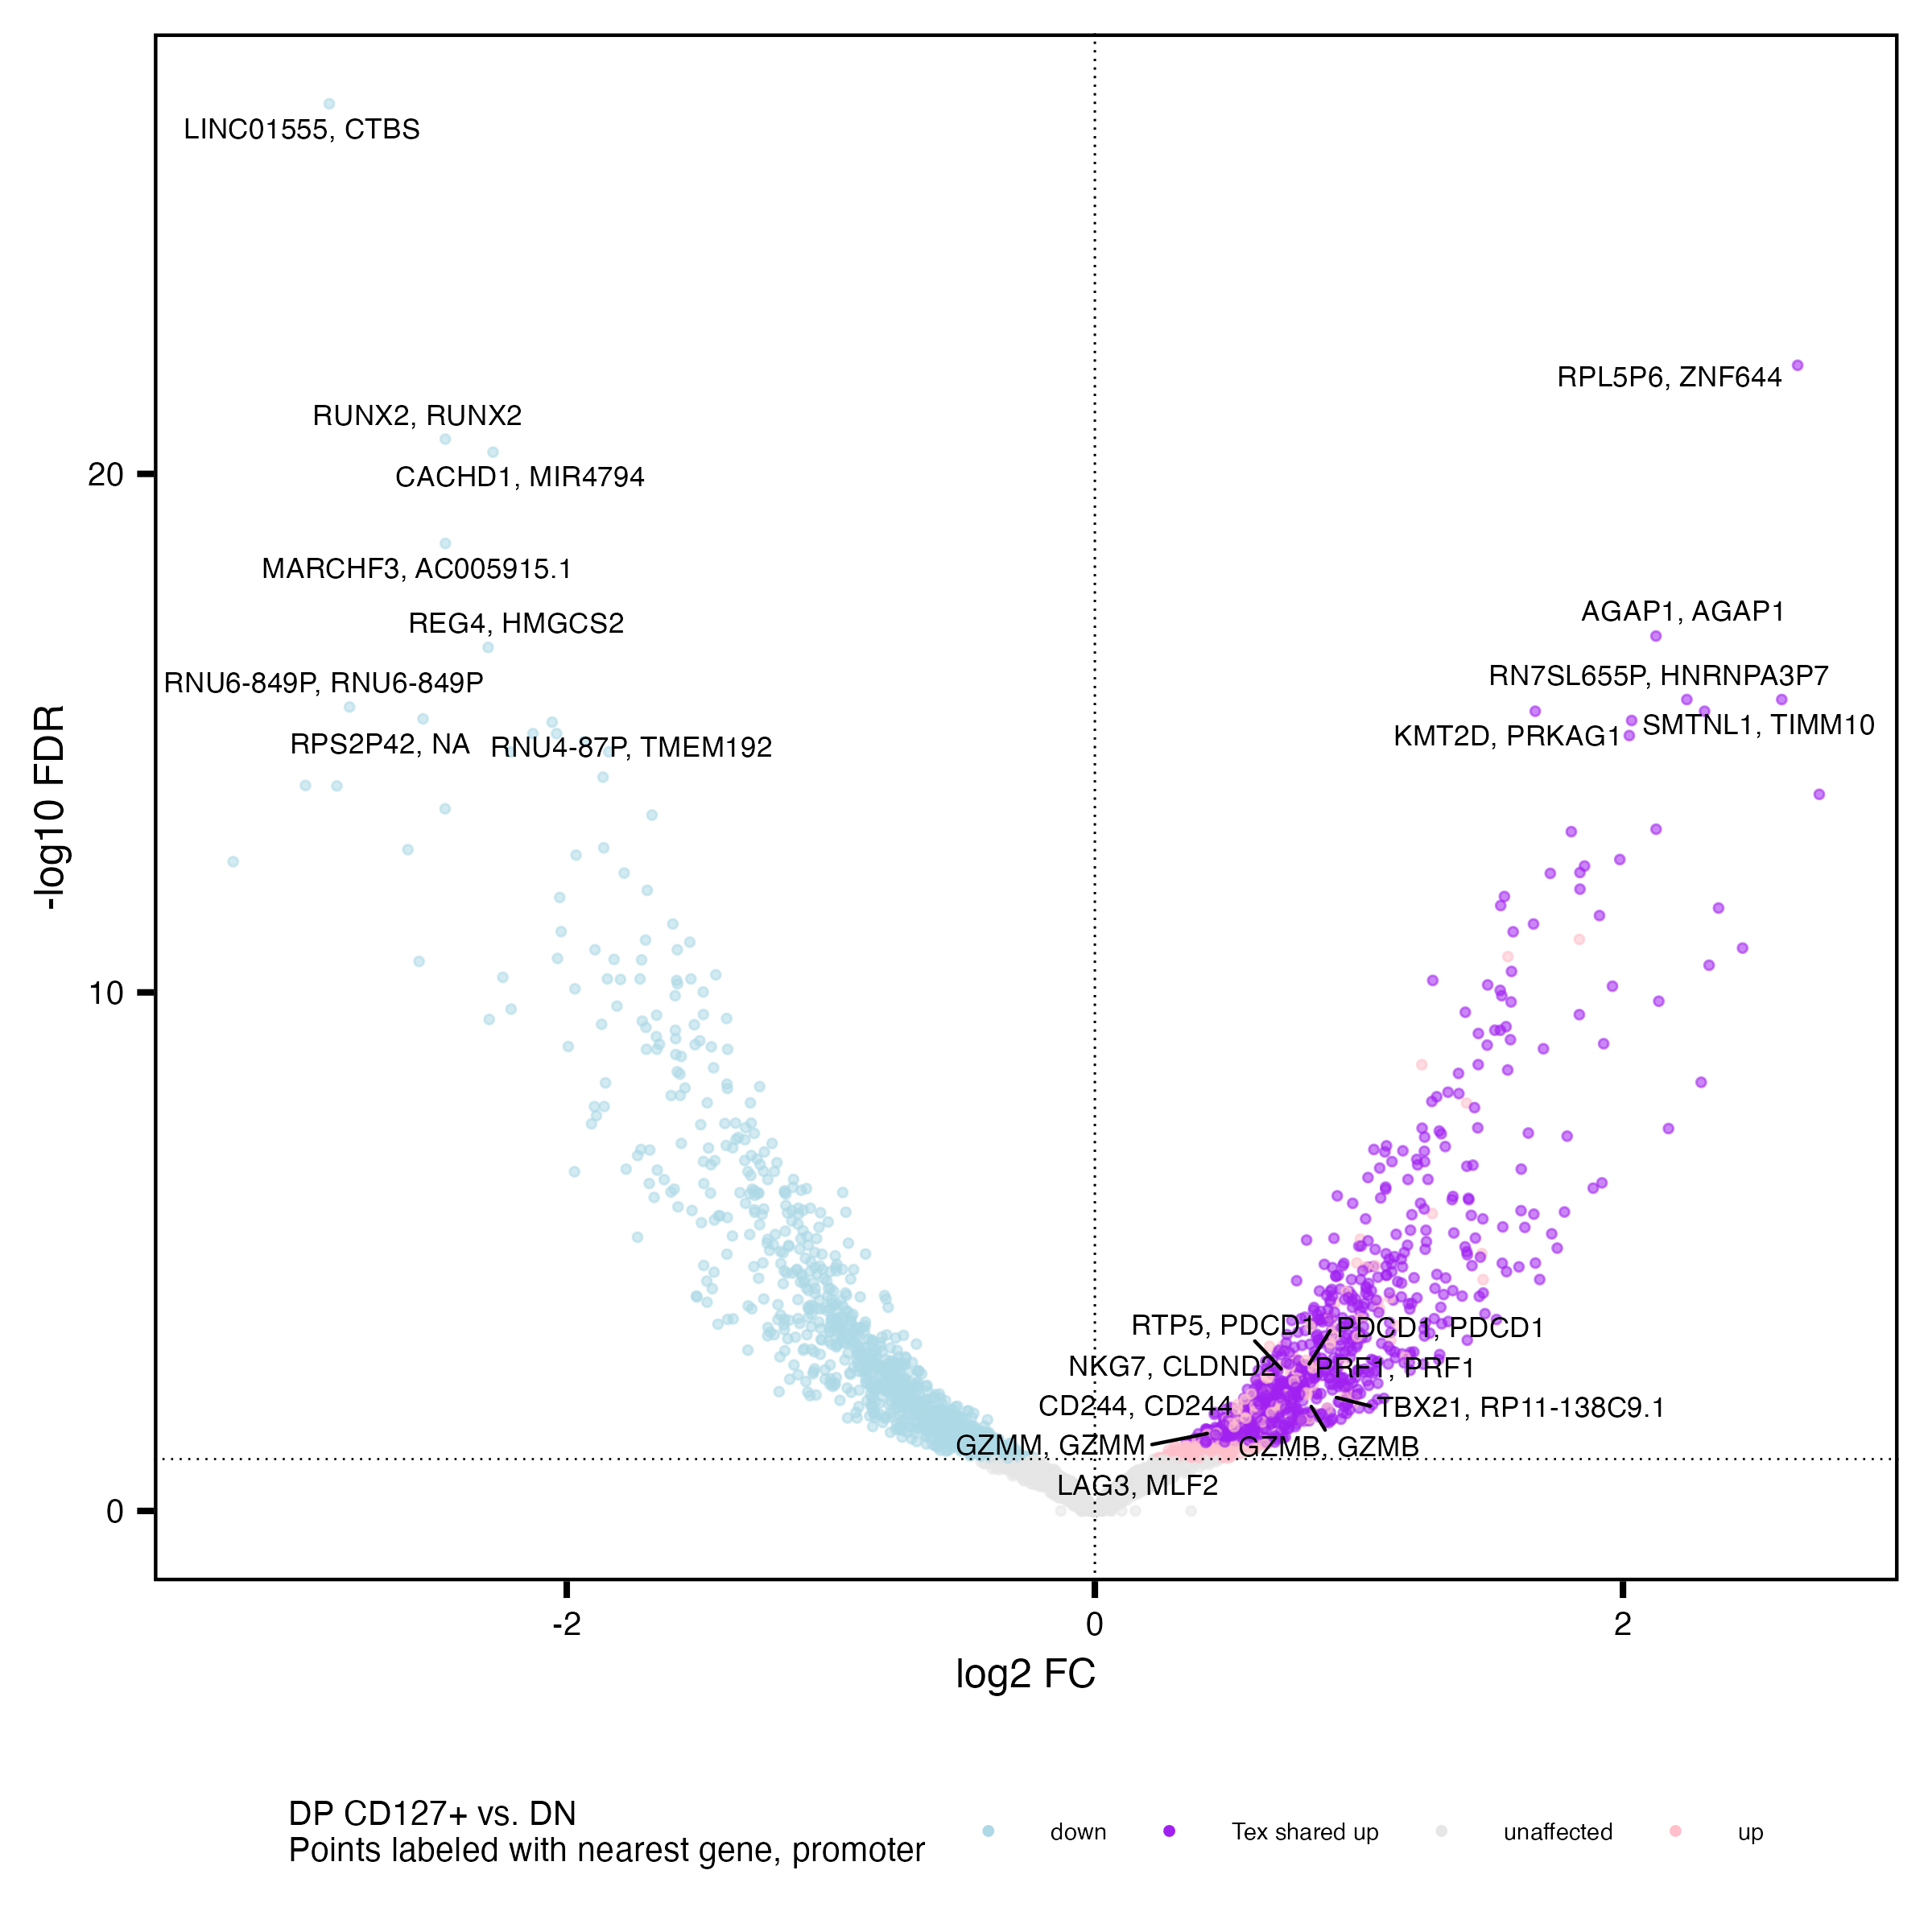
DP populations share many up vs. DN peaks’ genes with each other (colored purple)

Slide 19
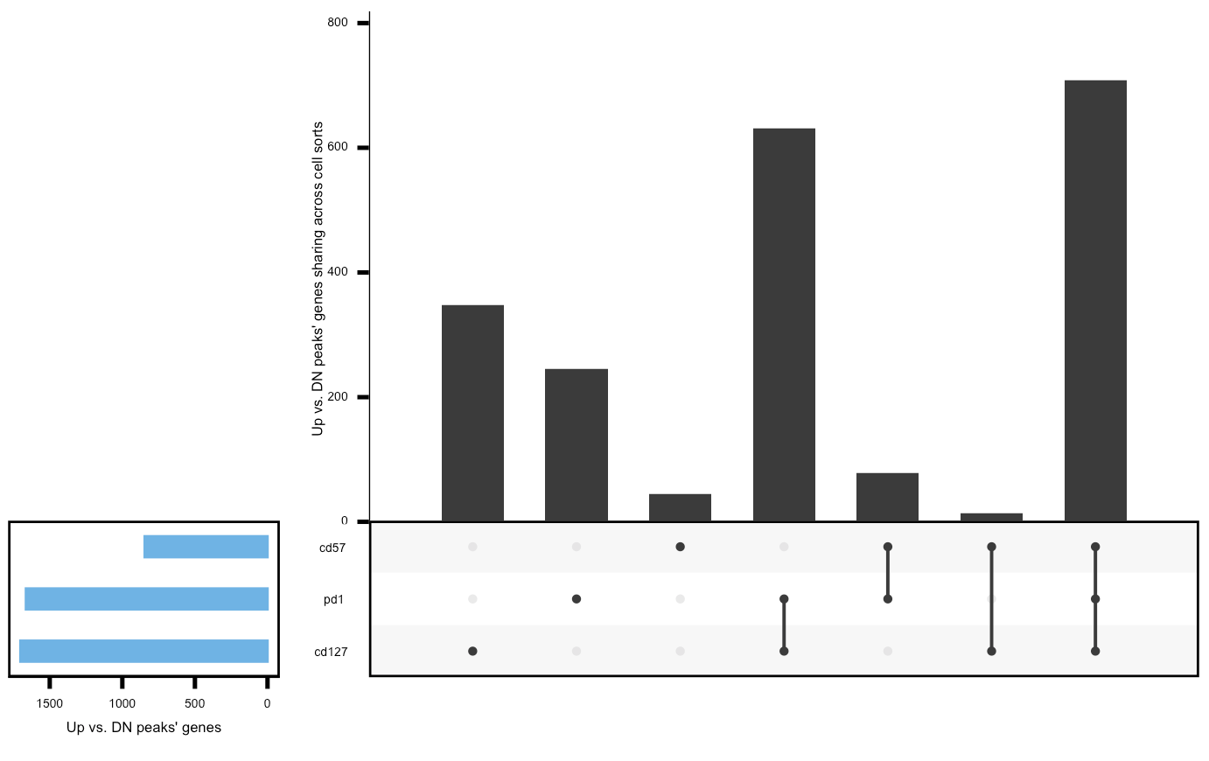
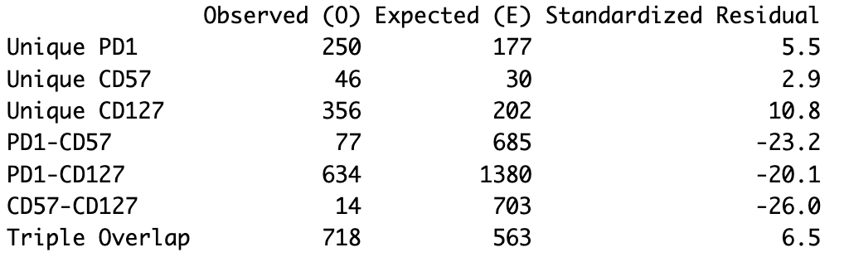
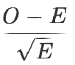
More than expected unique and triple overlap, less than expected double overlaps between peaks’ genes up in DP vs. DN
Expected values from simulations
2,095 distinct up genes vs. DN across DPs
Observed values
Notes:
filtered for significantly differentially accessible peaks with highest abs(FC) per gene (or promoter, similar results if using median)
then filtered for FC > 0 vs. DN
similar results if filtering for peaks < 5 kb from genes, looks similar for promoters
KIRs aren’t present in the unique to DP CD57⁺ fraction (not surprising, they don’t show up vs. DN, only vs. DP PD-1⁺)
5000 simulations

Slide 20
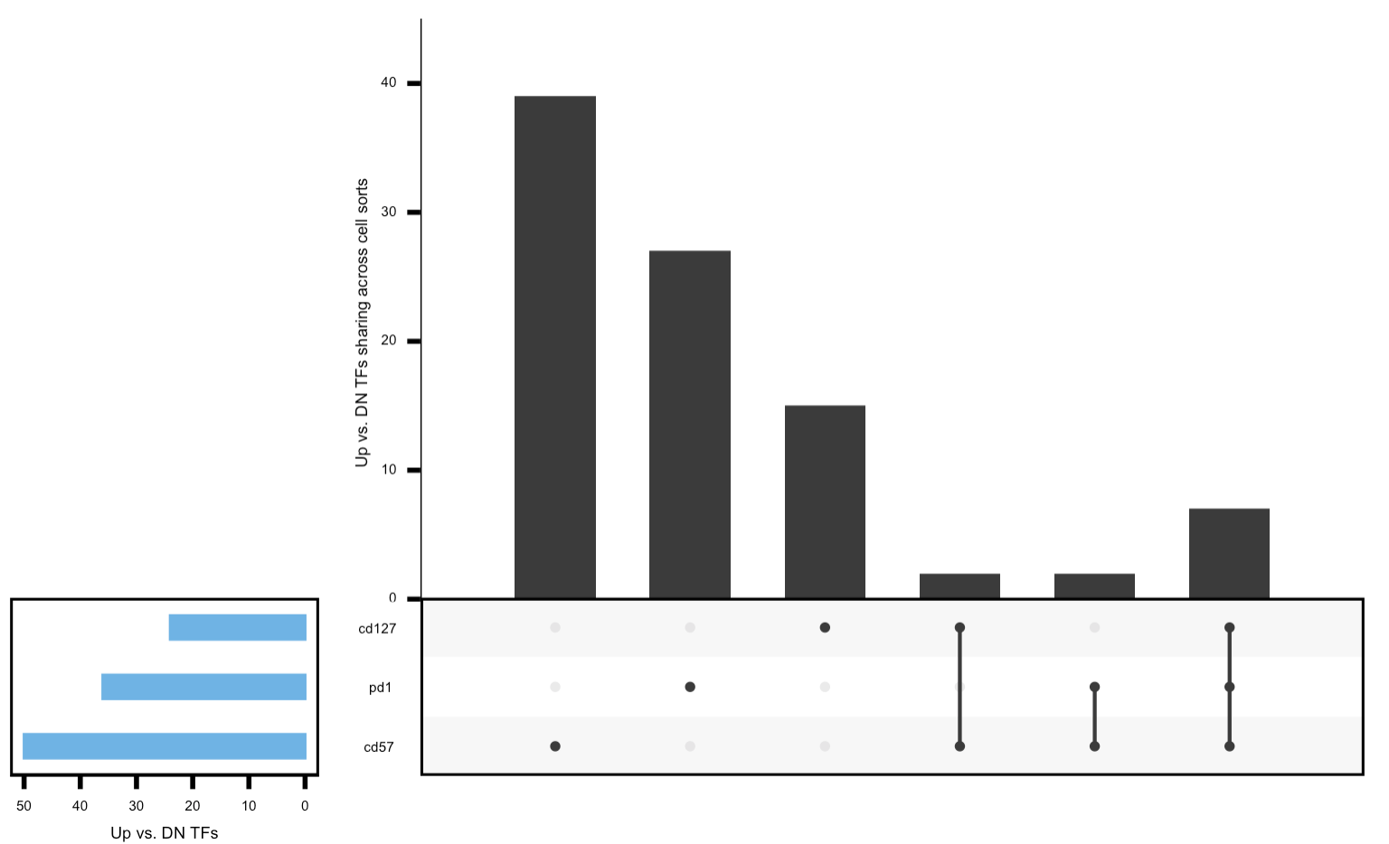
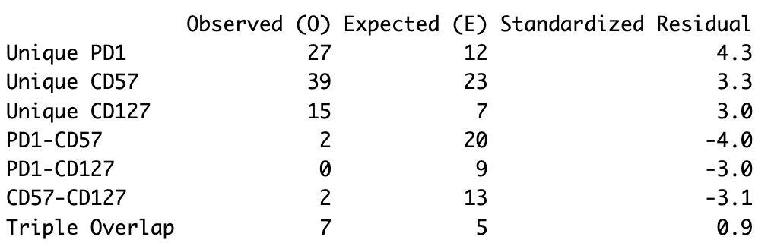
Again see more than expected unique, less than expected double overlaps between TFs up in DP vs. DN
Expected values from simulations
92 distinct up TFs vs. DN across DPs
Observed values

Slide 21
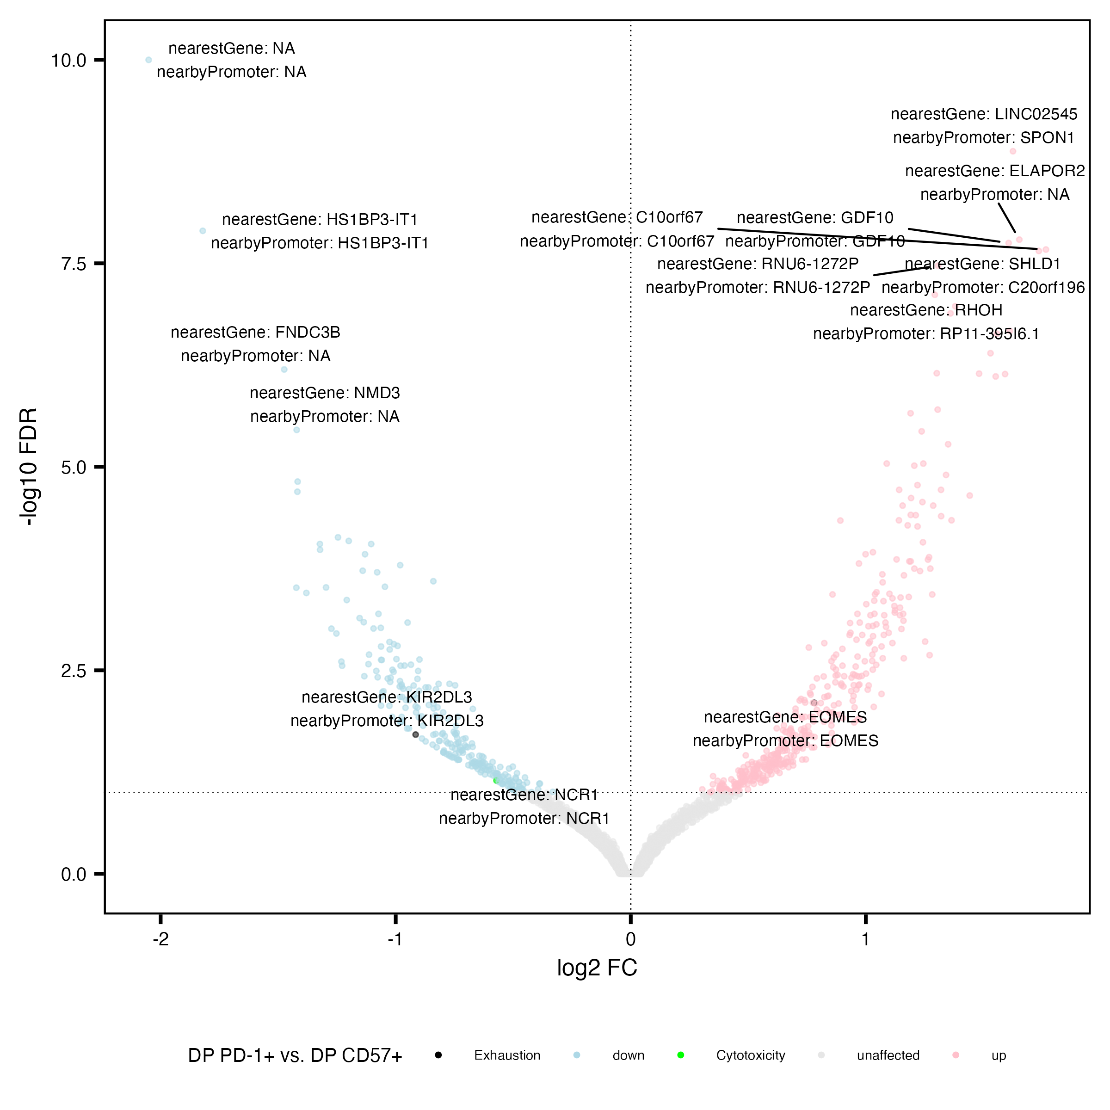
Peaks near KIR2DL3 and NCR1 more accessible in DP CD57⁺ vs. DP PD-1⁺
Similar to Erin’s P452 T1DAL analyses
Exhaustion: CD244, SLAMF6, TBX21, PDCD1, HAVCR2, KLRG1, TOX, TCF1, PD1, CTLA4, LAG3, TIM3, TIGIT, KIR3DL2, KIR2DL3, NKG2A
Cytotoxicity: GZMA, GZMB, GZMH, GZMM, GZMK, PRF1, NCR1, KLRF1, NKG7

Slide 22
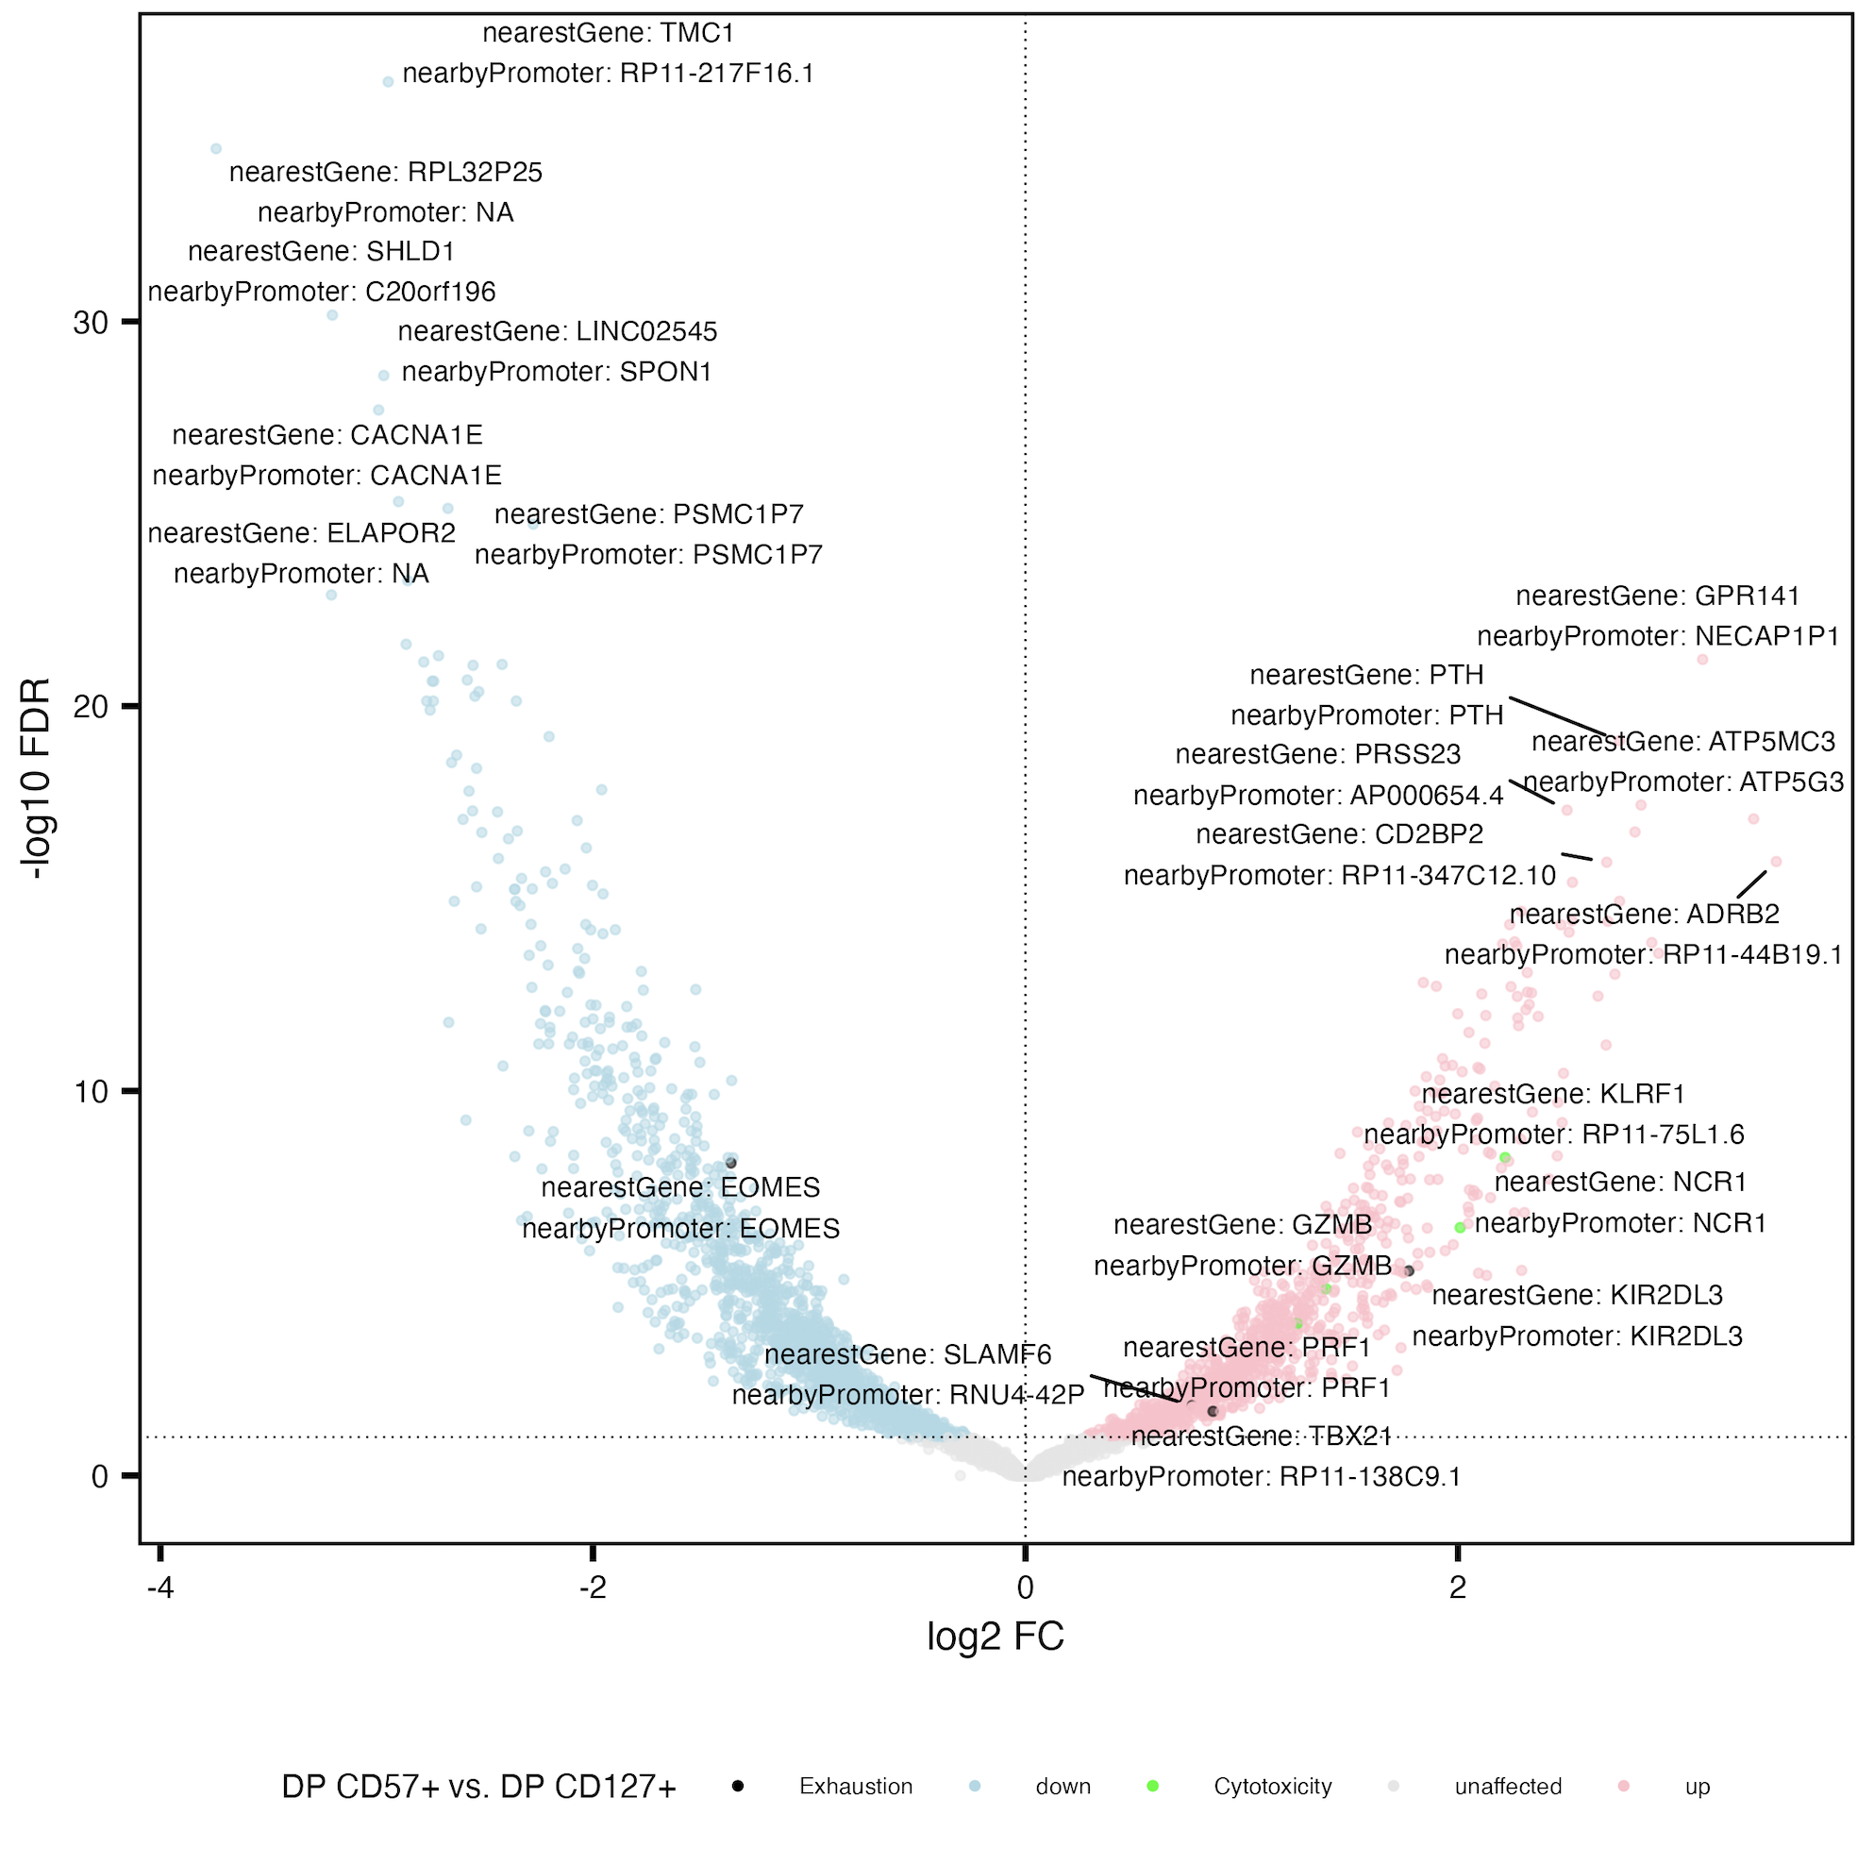
Peaks near KIR2DL3 and NCR1 also more accessible in DP CD57⁺ vs. DP CD127⁺
Exhaustion: CD244, SLAMF6, TBX21, PDCD1, HAVCR2, KLRG1, TOX, TCF1, PD1, CTLA4, LAG3, TIM3, TIGIT, KIR3DL2, KIR2DL3, NKG2A
Cytotoxicity: GZMA, GZMB, GZMH, GZMM, GZMK, PRF1, NCR1, KLRF1, NKG7

Slide 23
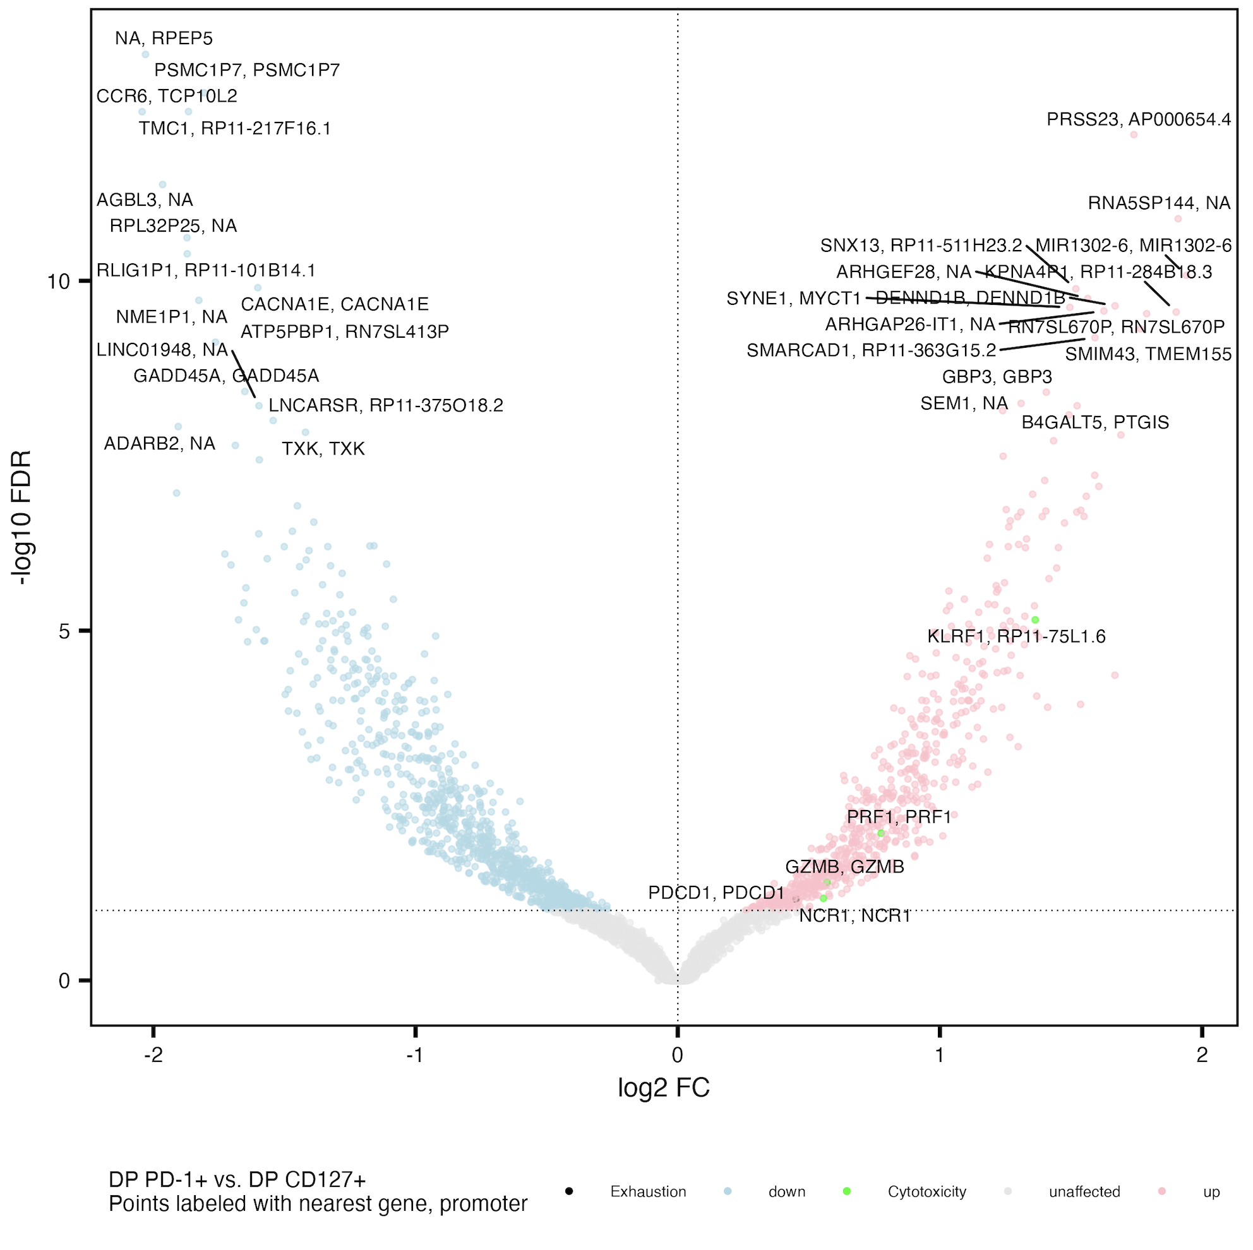
Cytotoxicity peaks’ genes more accessible in DP PD-1⁺ vs. DP CD127⁺
Exhaustion: CD244, SLAMF6, TBX21, PDCD1, HAVCR2, KLRG1, TOX, TCF1, PD1, CTLA4, LAG3, TIM3, TIGIT, KIR3DL2, KIR2DL3, NKG2A
Cytotoxicity: GZMA, GZMB, GZMH, GZMM, GZMK, PRF1, NCR1, KLRF1, NKG7

Slide 24
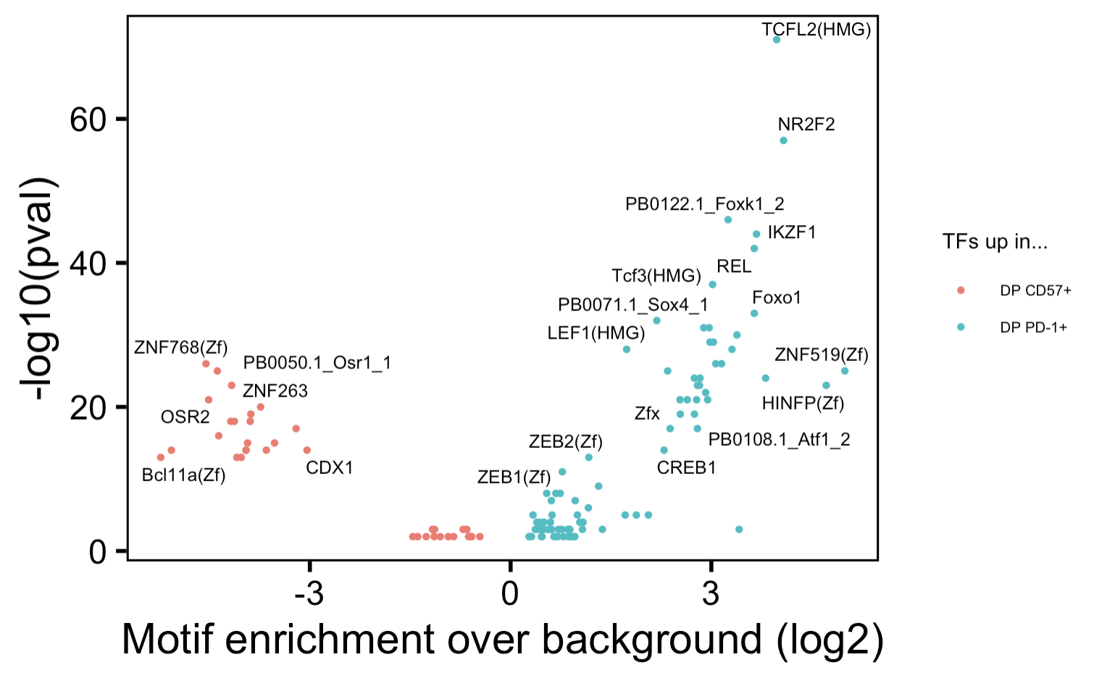
Distinct TFs enriched in DARs in DP PD-1⁺ vs. DP CD57⁺ contrast
~similar to Erin’s analyses in P452
Notes:
Tcf7 and Lef1 up in PD-1+ consistent between Erin’s and this projects, JunB being up in CD57+ also consistent (very low pval here though)
Fosl2 up in Erin’s CD57+ vs. PD-1+… here I see it up in CD127+ vs. PD-1+… also see Lef1 up here in CD127+ vs. PD-1+

Slide 25
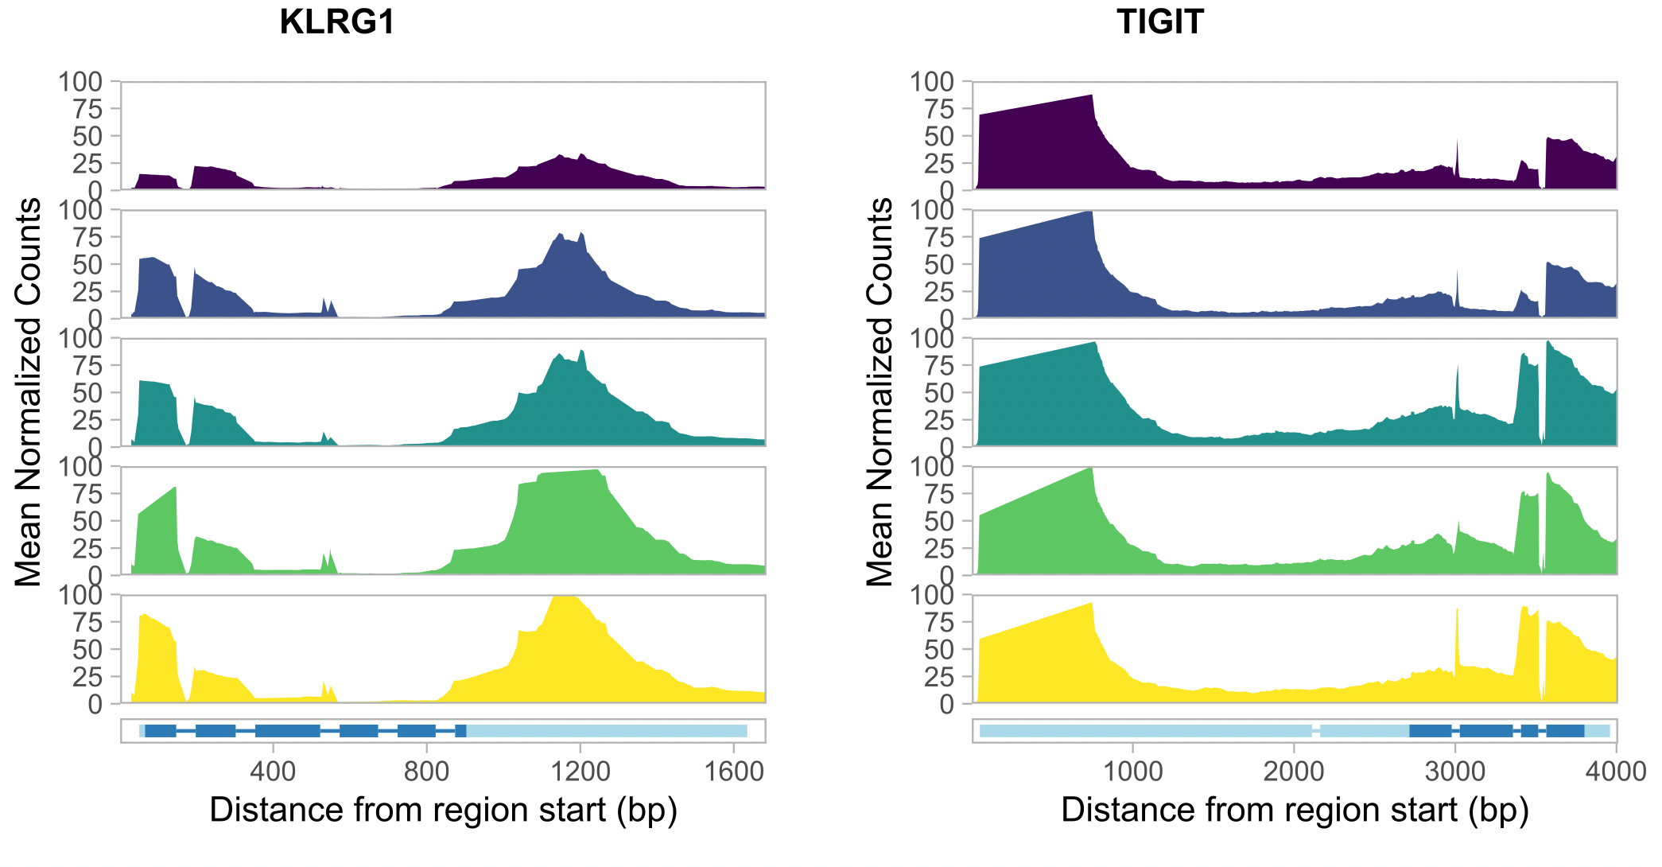
As expected, KLRG1 and TIGIT genes (slightly) more accessible in DP cell populations

Slide 26
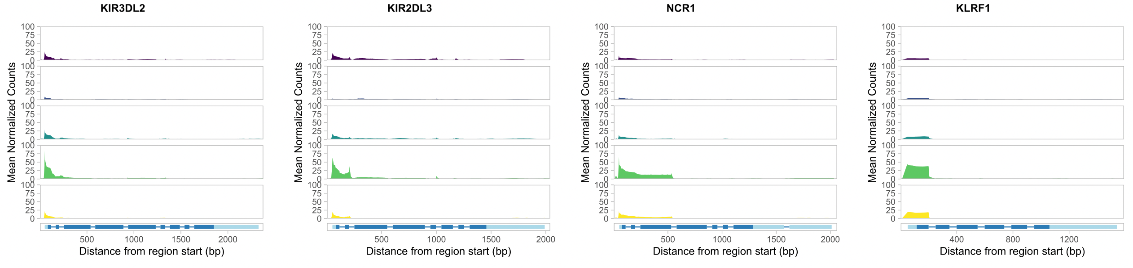
NCR1, KLRF1, and KIR genes more accessible in DP CD57⁺, as seen in Erin’s P452 analyses

Slide 27
Conclusions
Responders and non-responders to teplizumab have similar epigenetic profiles in non-naïve CD8s
Epigenetic profiles of cell types differ
PD-1⁺ and CD57⁺ T_{ex} appear epigenetically exhausted yet distinct (as observed with and similar to epigenetic profiles with alefacept in TIDAL (Witkop, Commun Biol))

Slide 28
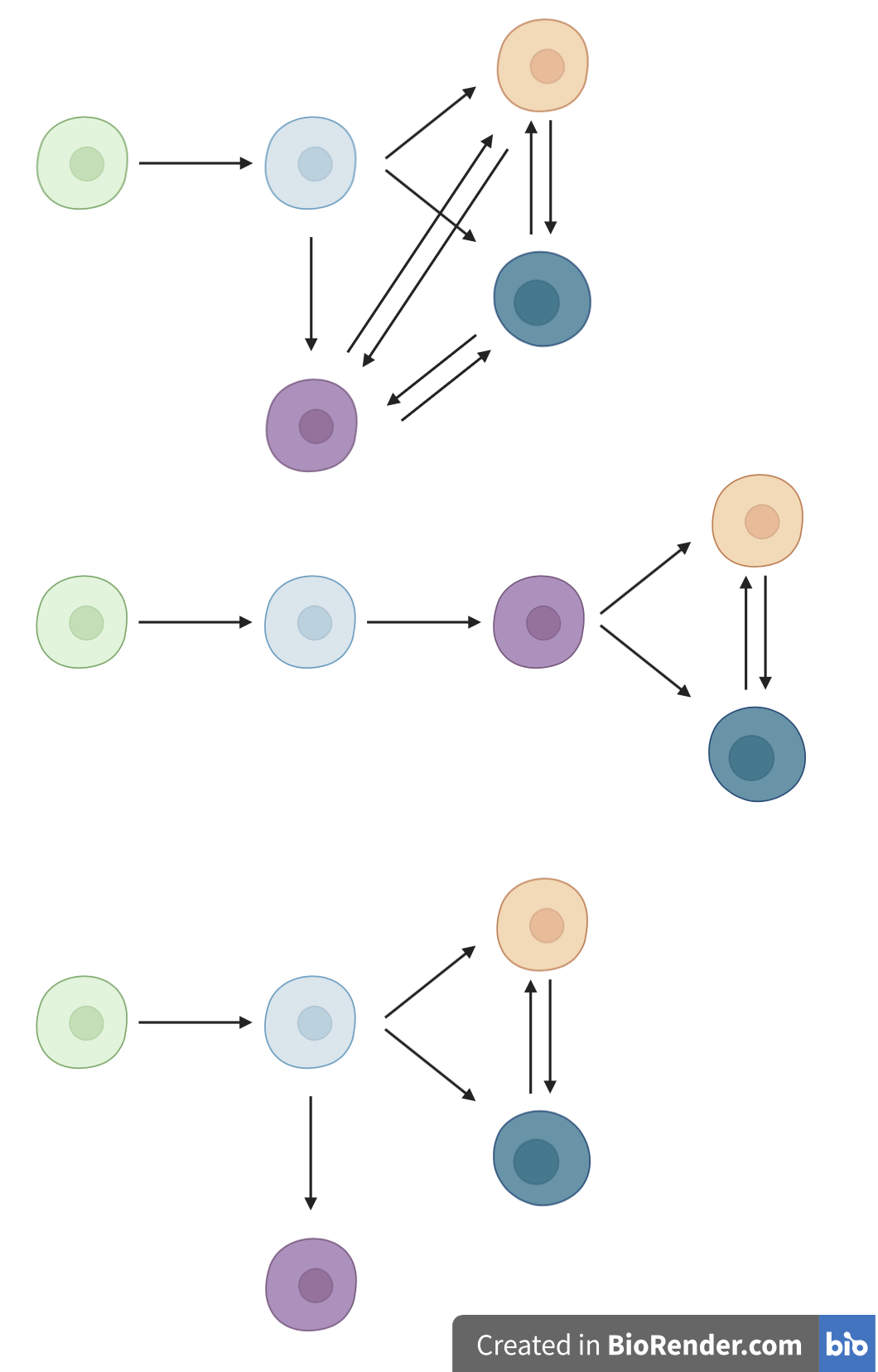
Perhaps more complex lineage models are needed
Model 1
Having ATACseq data from TIGIT⁺KLRG1⁺ parent cell sort perhaps could support models (i.e. is DP CD127+ more similar than other DPs to parent DP which would support model 2 here)
DP PD-1⁺
DP
CD127⁺
Model 2
TIGIT⁻
KLRG1⁻
TIGIT⁺
KLRG1⁺ (DP)
DP CD57⁺
Model 3

Slide 29
Next steps
Observed vs. expected sharing comparisons for DP vs. DP peaks’ genes and TFs
Explore non-exhausted CD127⁺ population
Make heatmaps of genes’/promoters’ accessibility by cell population
Investigate variability between donors in mean coverage plots and Homer analyses
P452 data: compare Homer results pre/post- downsampling read counts to levels similar to those here in P576 (i.e. is it worth $ to sequence P576 to greater depth)
Infer meaning from KEGG enrichment analyses
PPIs also from peaks’ closest promoters

Slide 30

Acknowledgements
Peter Linsley
Long lab
Josh Centore
Alice Wiedeman
Alice Long
Bioinformatics group
Erin Witkop
Stephan Pribitzer
Basilin Benson

Slide 31
Extra slides

Slide 32
DP T_{ex} populations are heterogeneous, overlapping
Notes:
CyTOF data I think

Slide 33
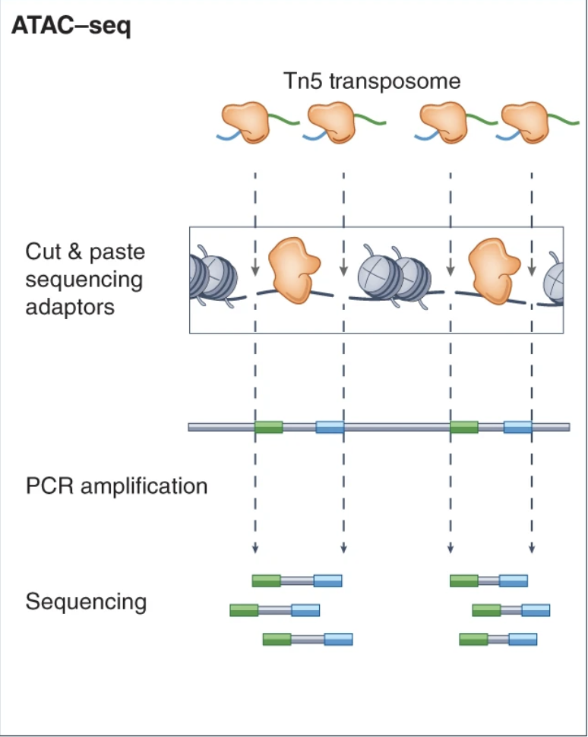
ATACseq workflow

Slide 34
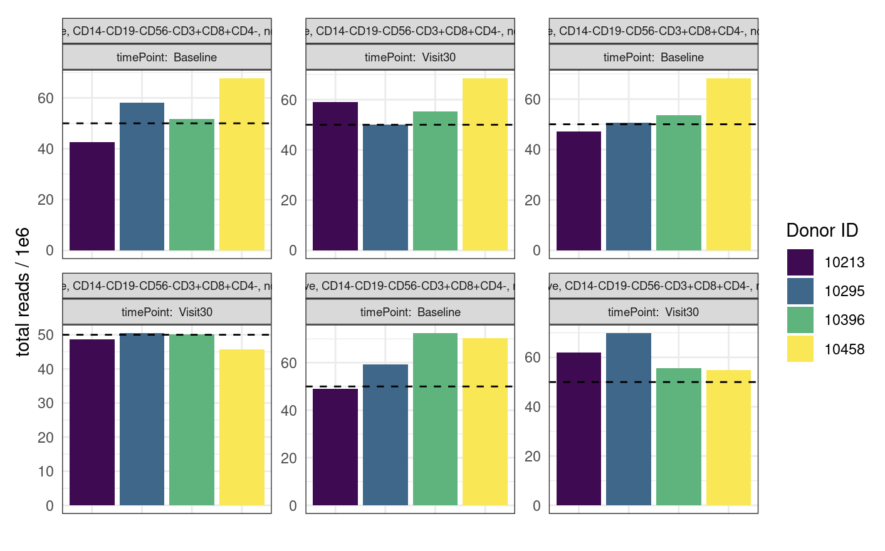
P452 QC comparable to that of P576-1 but does have more reads

Slide 35
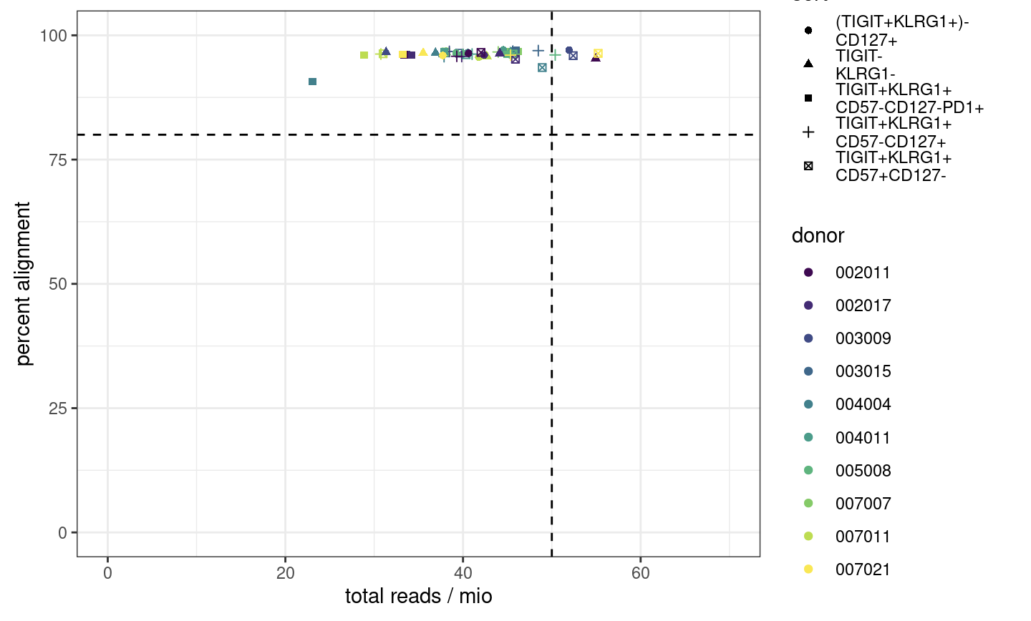
Alignment passes QC
Notes:
ENCODE recommends 50 mio (aligned) reads for paired-end, 25 mio for single read
ENCODE: each replicate should have 25 million non-duplicate, non-mitochondrial aligned reads for single-end sequencing and 50 million for paired-ended sequencing (i.e. 25 million fragments, regardless of sequencing run type). The alignment rate, or percentage of mapped reads, should be greater than 95%, though values > 80% may be acceptable
want 10-50 mil reads depending on if TF analysis required (ENCODE suggestions)
we now want our samples to fall into the top right corner
consequences: may have reduced sensitivity (for low abundance/rare stuff), increased noise, decreased reproducibility across replicates (i.e. within sort+responder groups)
P452 may have had more reads/library because less libraries for the flowcell… Vivian expected P576-1 reads average around 50M but they were on average lower…

Slide 36
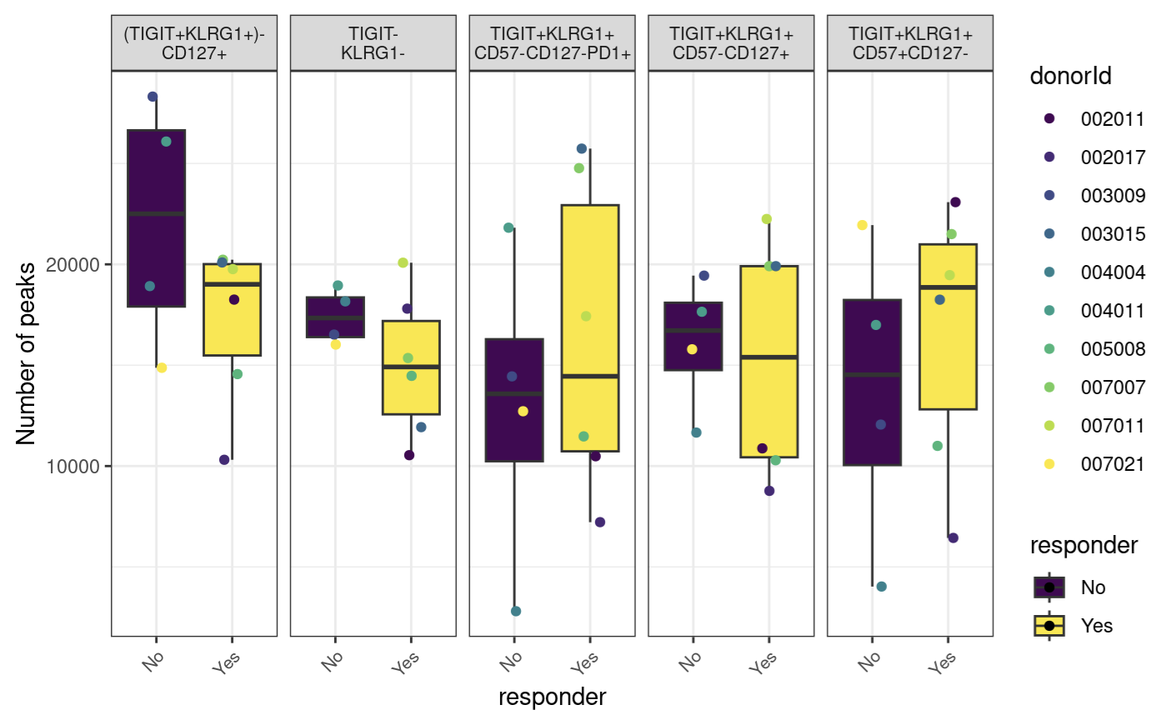
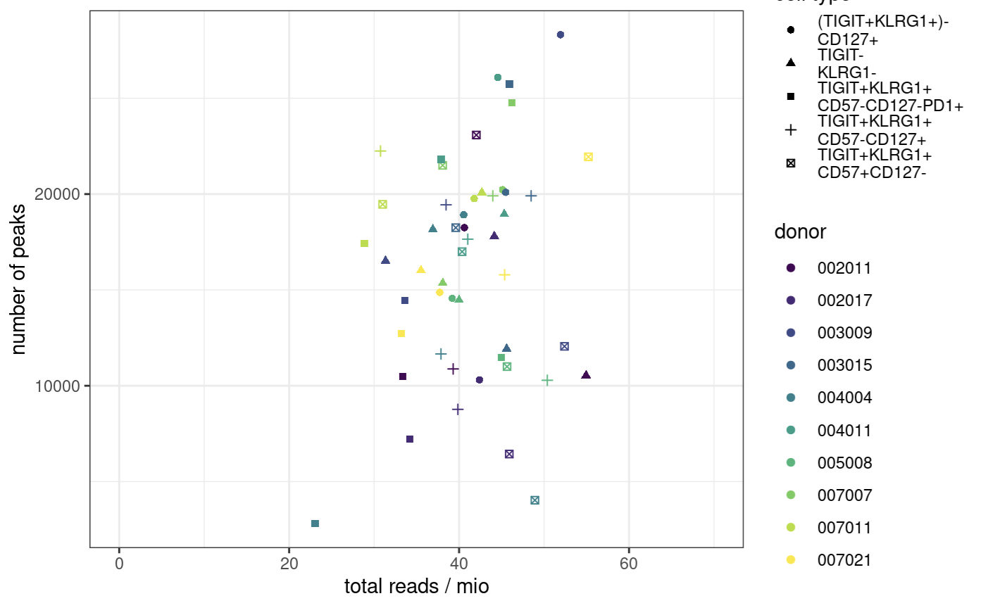
Peak counts
Notes:
ENCODE:The number of peaks within a replicated peak file should be >150,000, though values >100,000 may be acceptable.
ENCODE recommends > 150,000 peaks, although > 100,000 is still acceptable

Slide 37
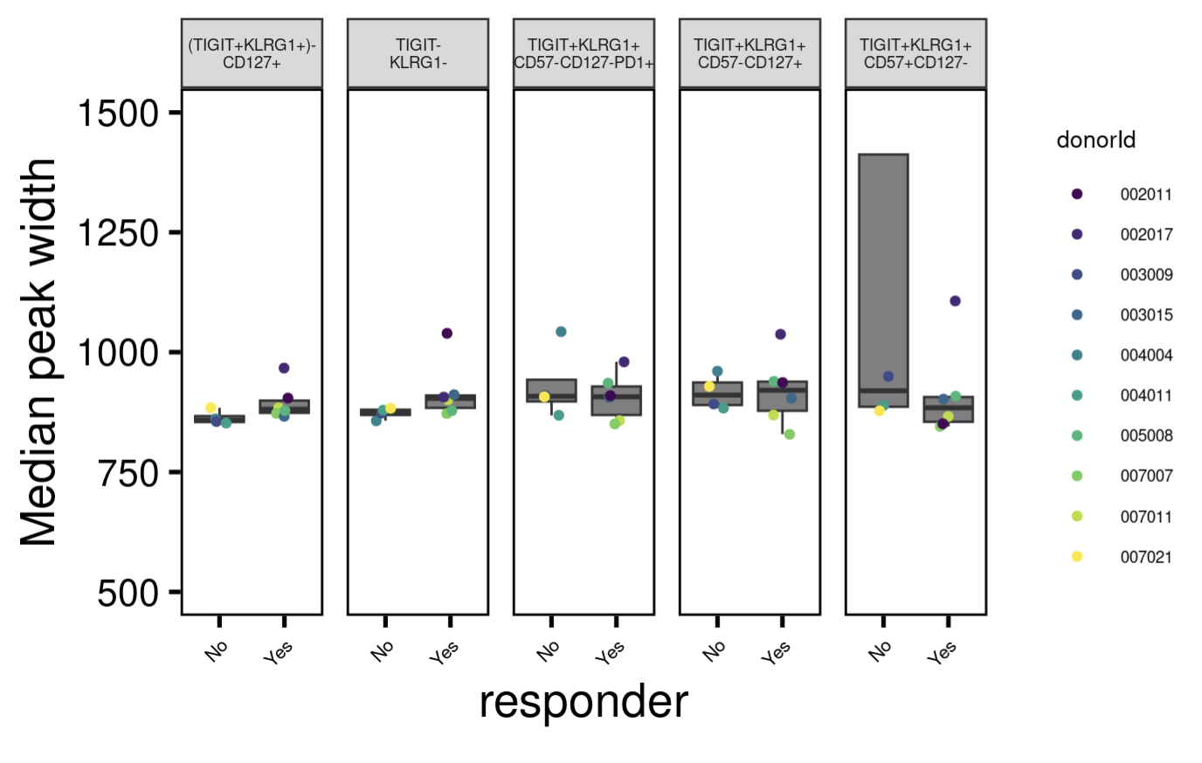
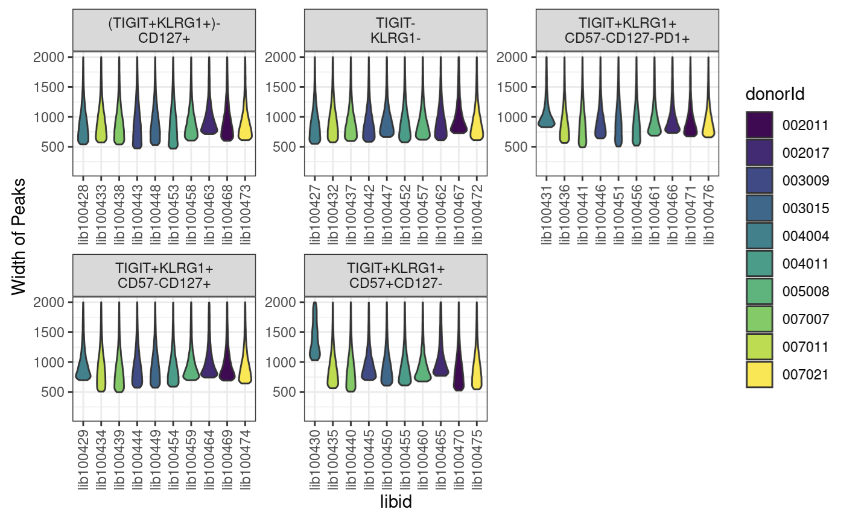
Peak widths
Notes:
want ~400-1000 bp peak widths as medians
libid100430 is wide peak one

Slide 38
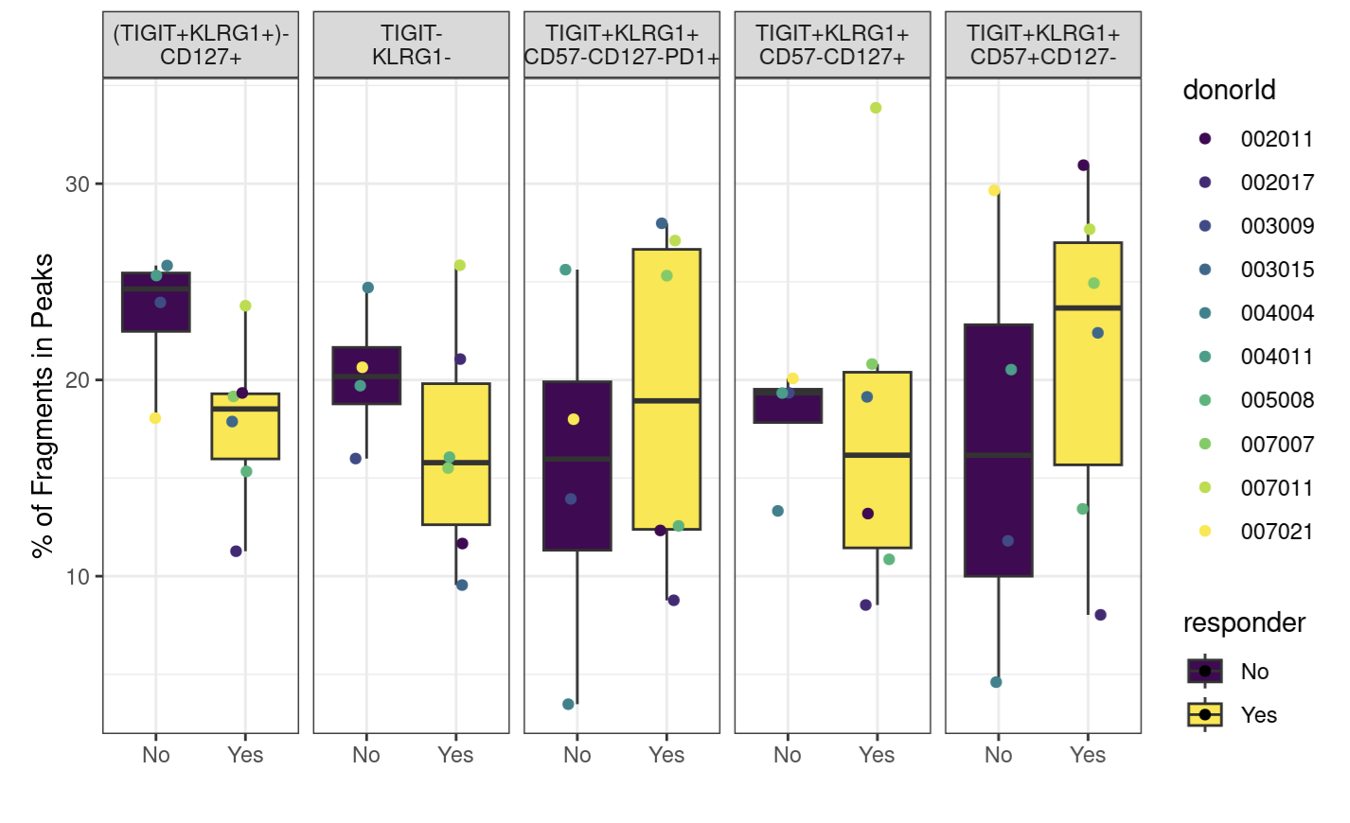
Fraction of reads in peaks
Notes:
ENCODE: The fraction of reads in called peak regions (FRiP score) should be > 0.3, though values greater than 0.2 are acceptable. TSS enrichment remains in place as a key signal to noise measure
FRiP is calculated by going through the bam files and counting the reads that fall within a called peak

Slide 39
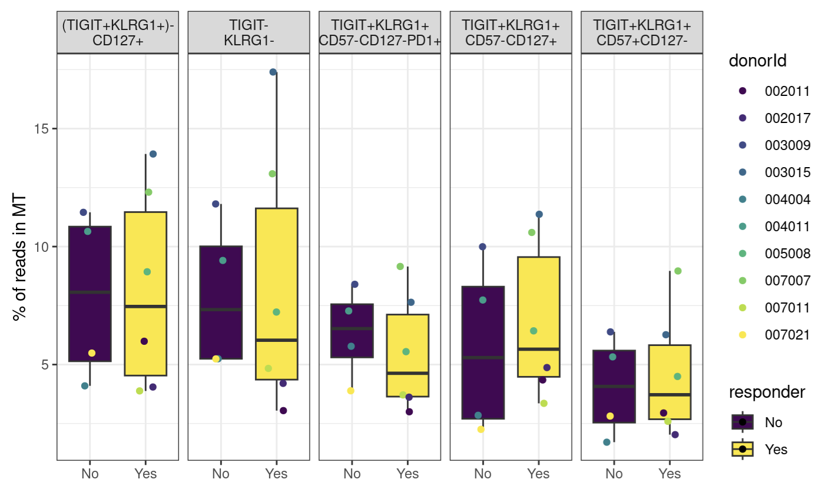
Percent of reads mapping to mitochondrial genome

Slide 40
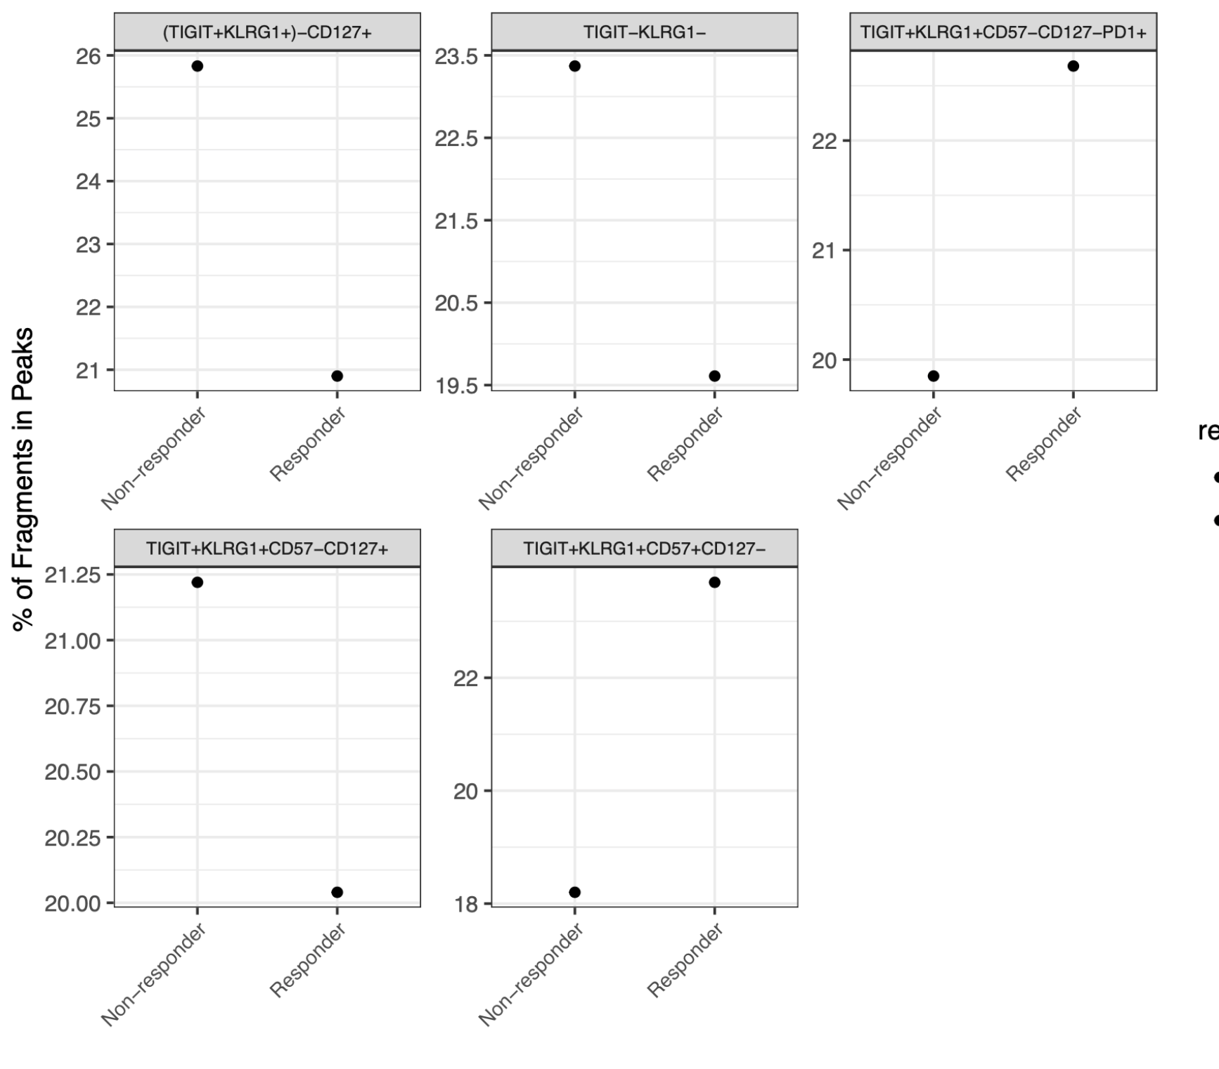
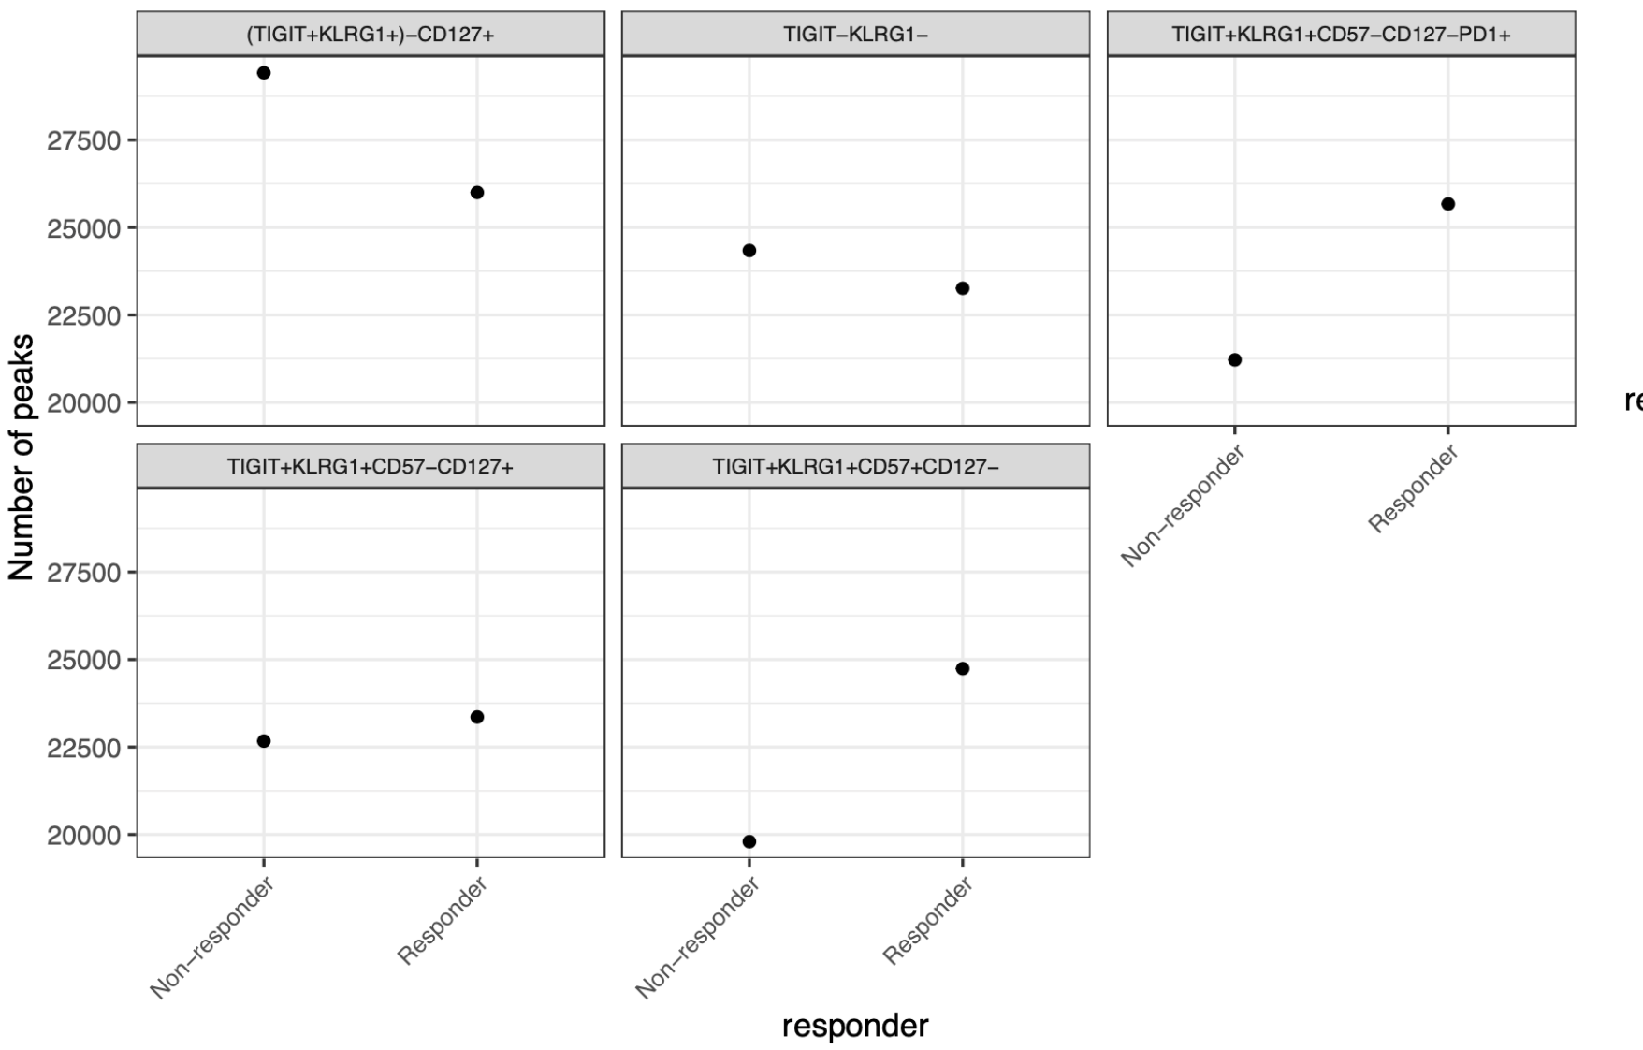
As expected, FRiPs are higher after merging alignment and peak files; peak counts are still lower than expected (still similar to P452)
Notes:
Merging:
Old Erin way: make the consensus peak set using peaks identified in at least two samples
New Stephan way: merged peaks from peaks called on merged alignment files by study group?

Slide 41
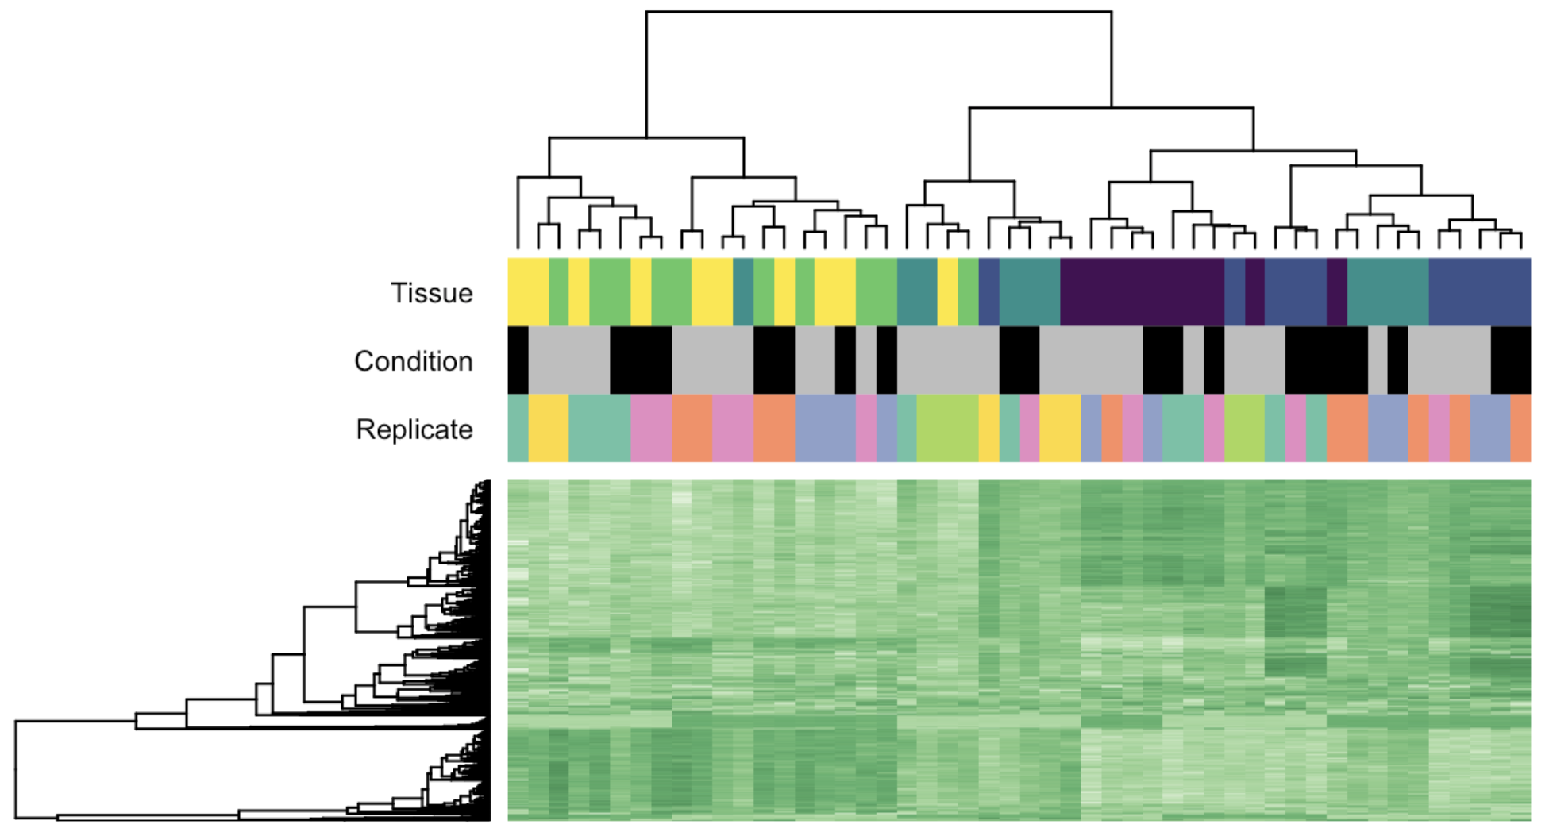
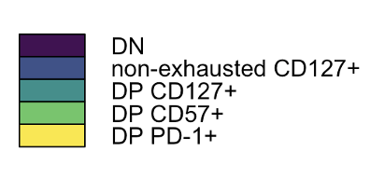
Cell population, rather than responder status, drives epigenetic differences
Cell population
Cell population
Responder status
Donor
Responder status
Non-responder
Responder

Slide 42
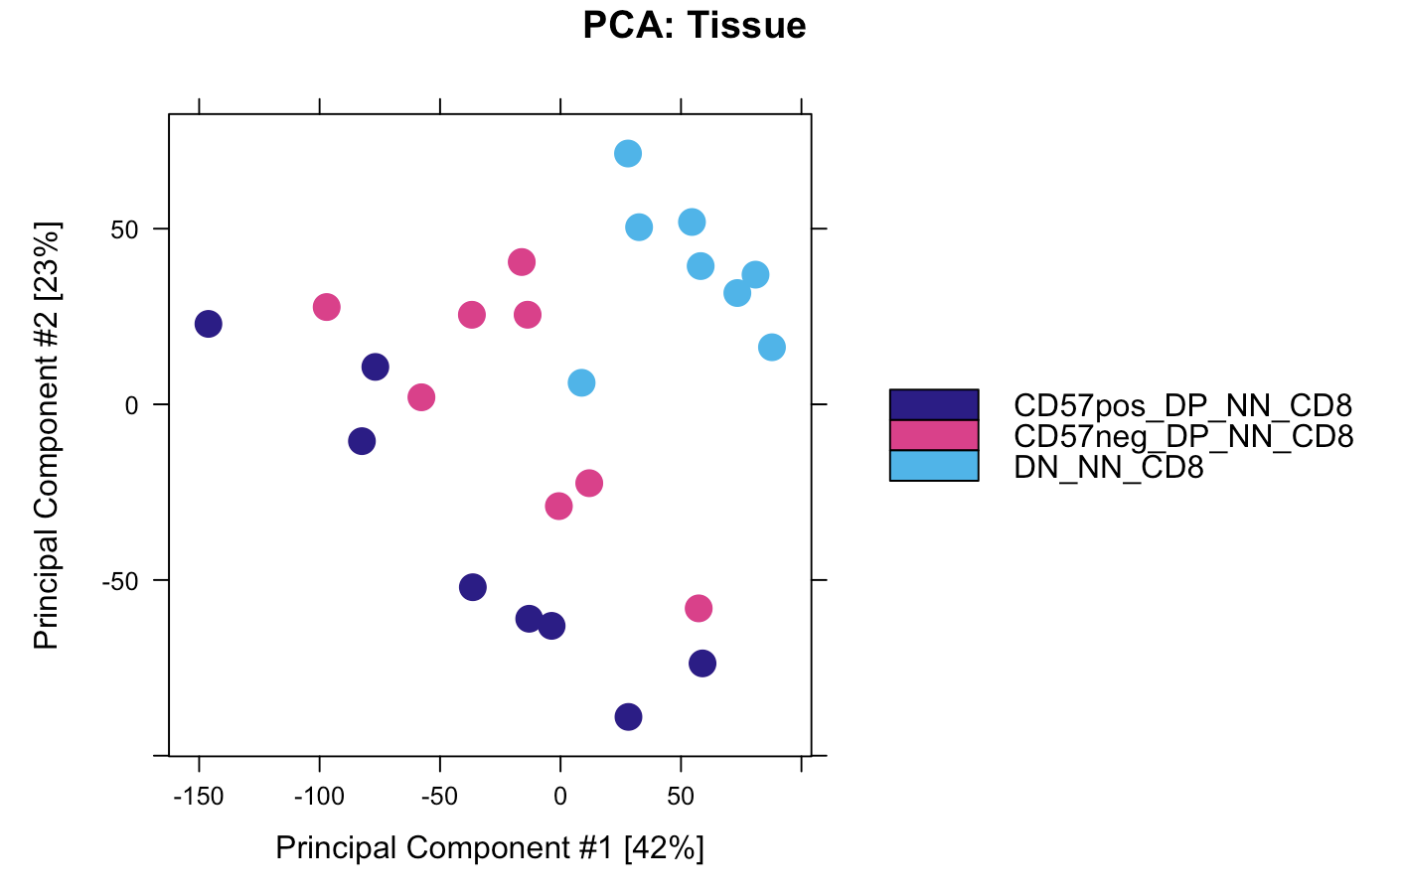
DP CD57⁺ and DP PD-1⁺ also cluster away from DN in P452, DP PD-1⁺ being more intermediate
Notes:
CyTOF data I think

Slide 43
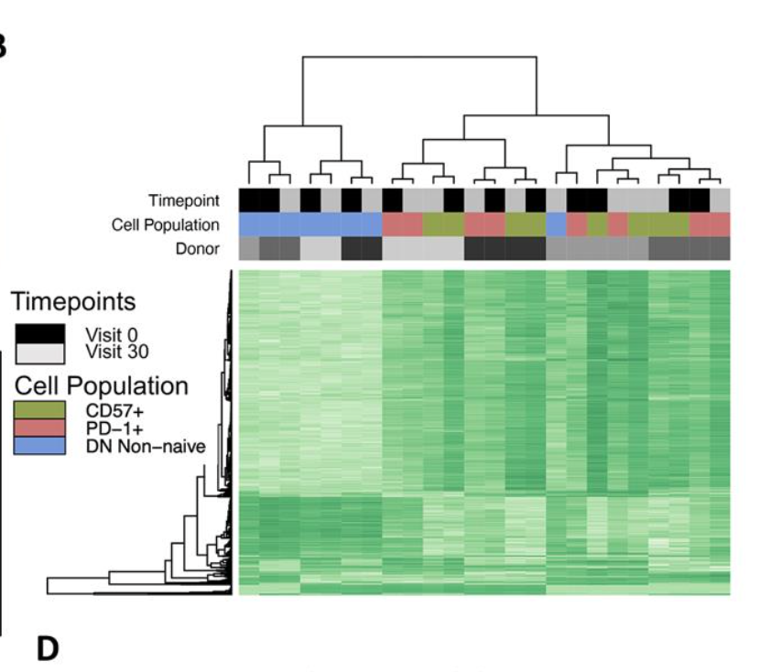
DP CD57⁺ and DP PD-1⁺ also cluster together away from DN in P452, timepoint does not drive clustering here

Slide 44
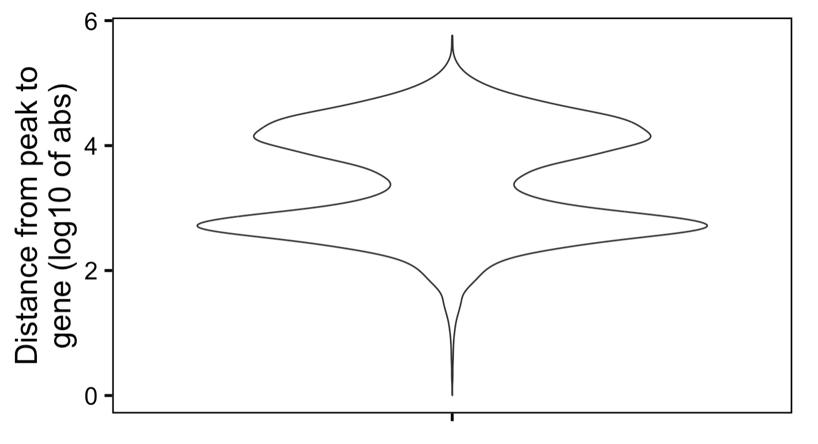
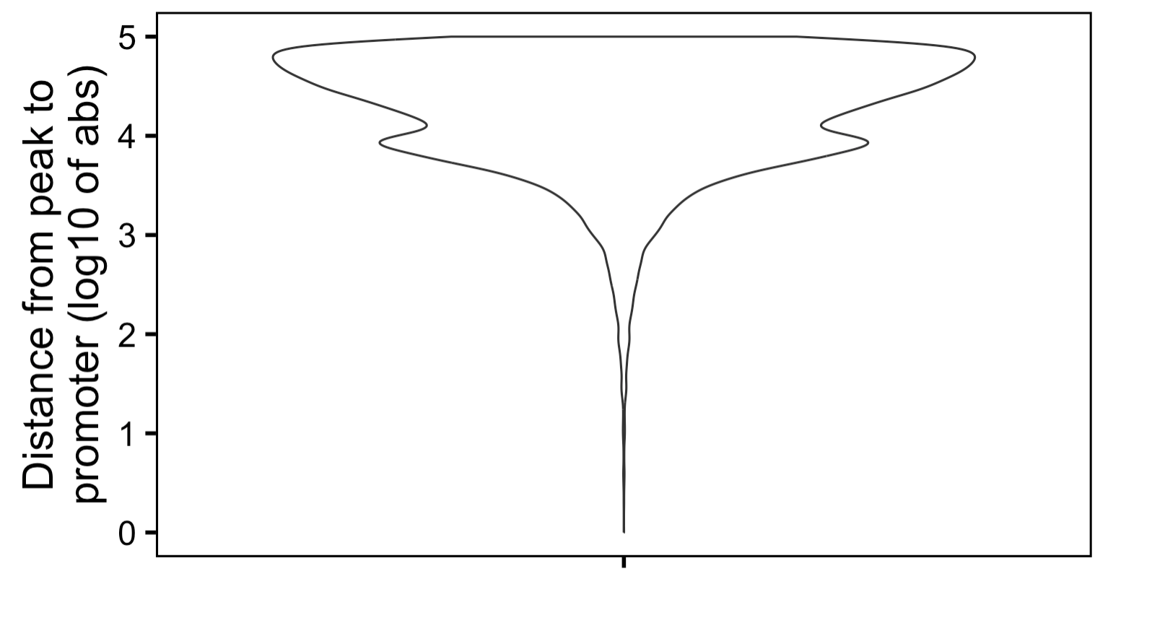
Most peaks are not very close to genes and are very far away from promoters
Notes:
This is from PD-1+ vs. DN contrast

Slide 45
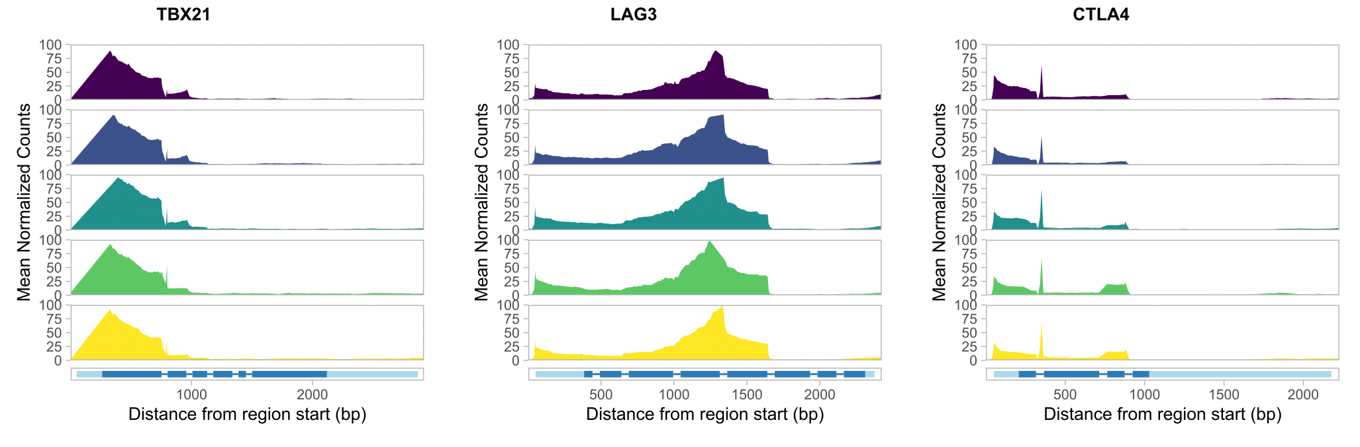
Exhaustion genes similarly accessible in cell populations
Notes:
Tex cells lack open chromatin sites in *Ifng* locus in Teff/TEM cells, Tex cells have open chromatin sites in *Pdcd1* locus (PD1), i.e. Teff down IR up it tracks

Slide 46
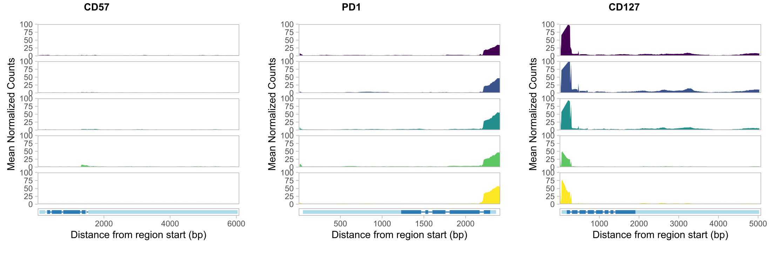
CD57, PD-1, and CD127 genes slightly more accessible in their sorted populations

Slide 47
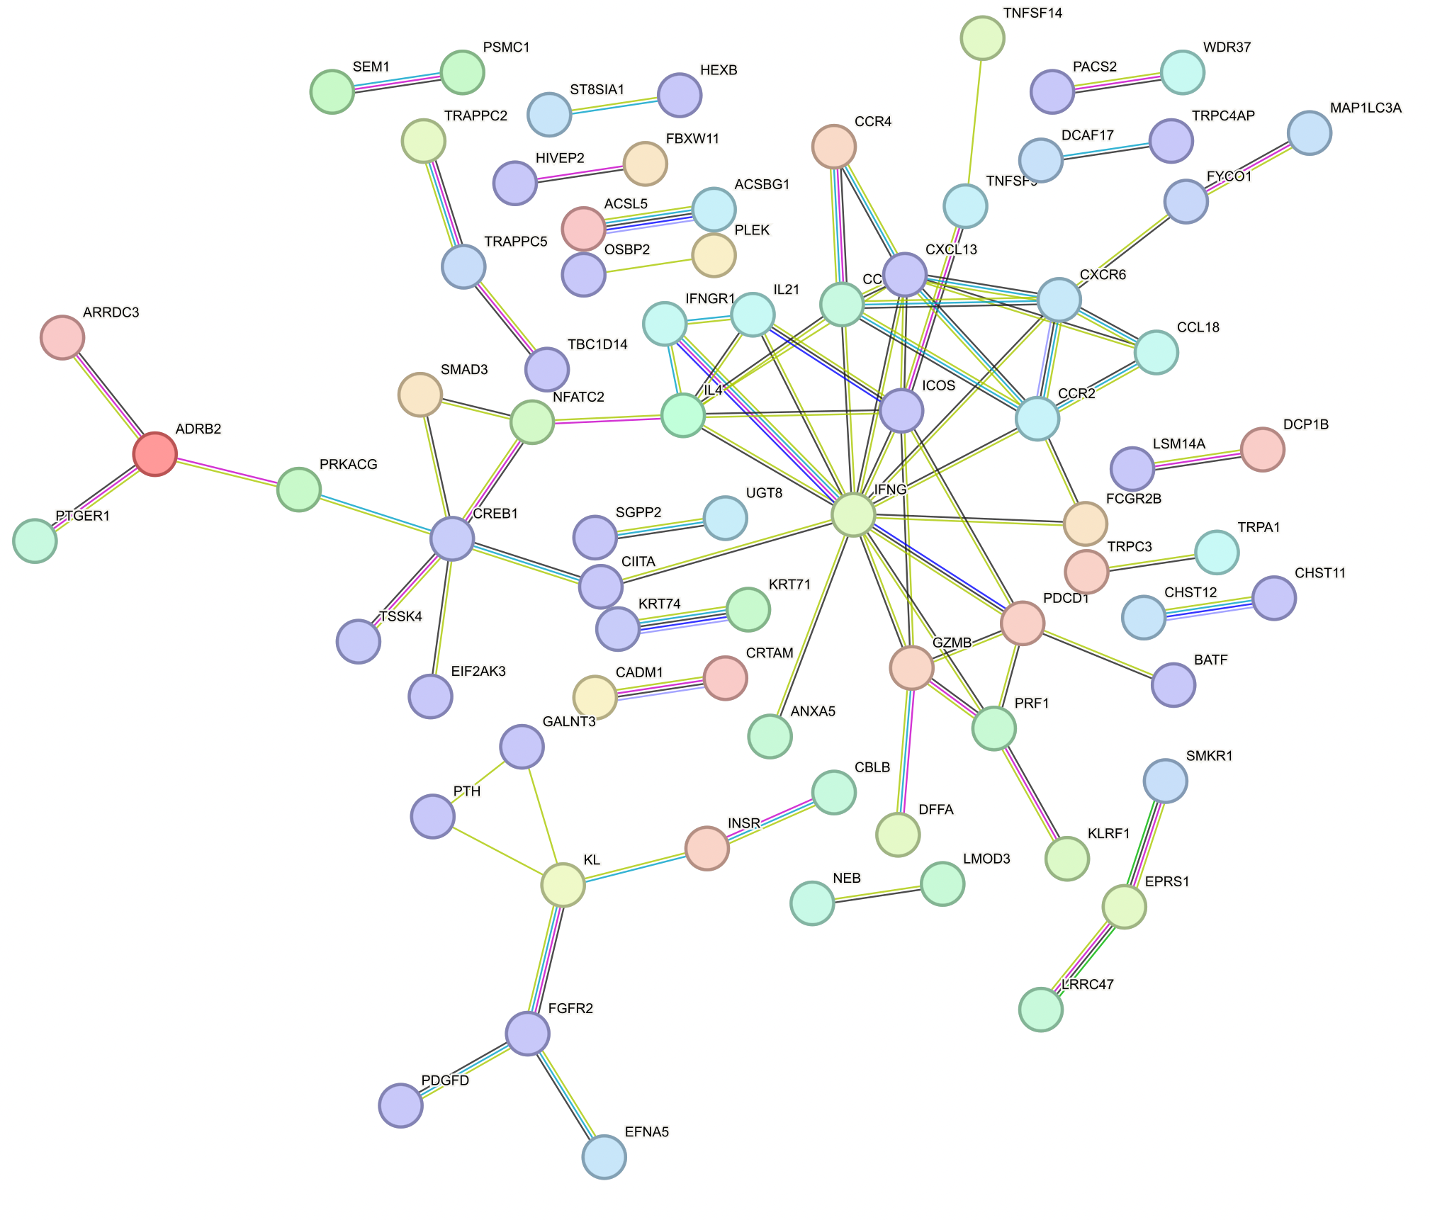
Central IFNG cluster in peaks’ genes up in DP PD-1⁺ vs. DN

Slide 48
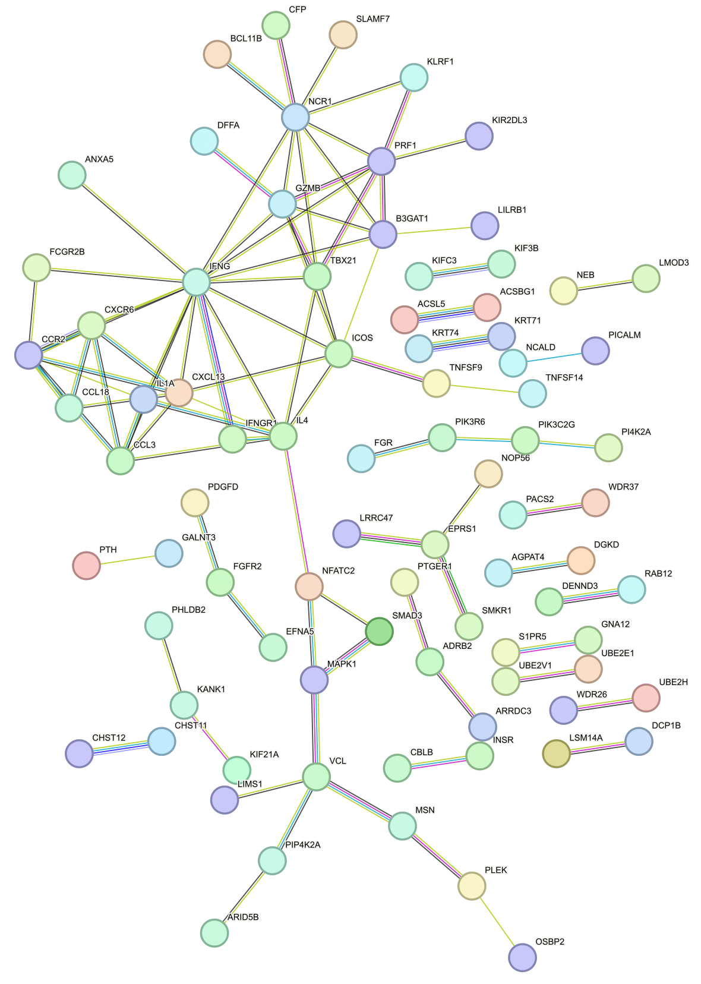
Central IFNG cluster in peaks’ genes up in DP CD57⁺ vs. DN

Slide 49
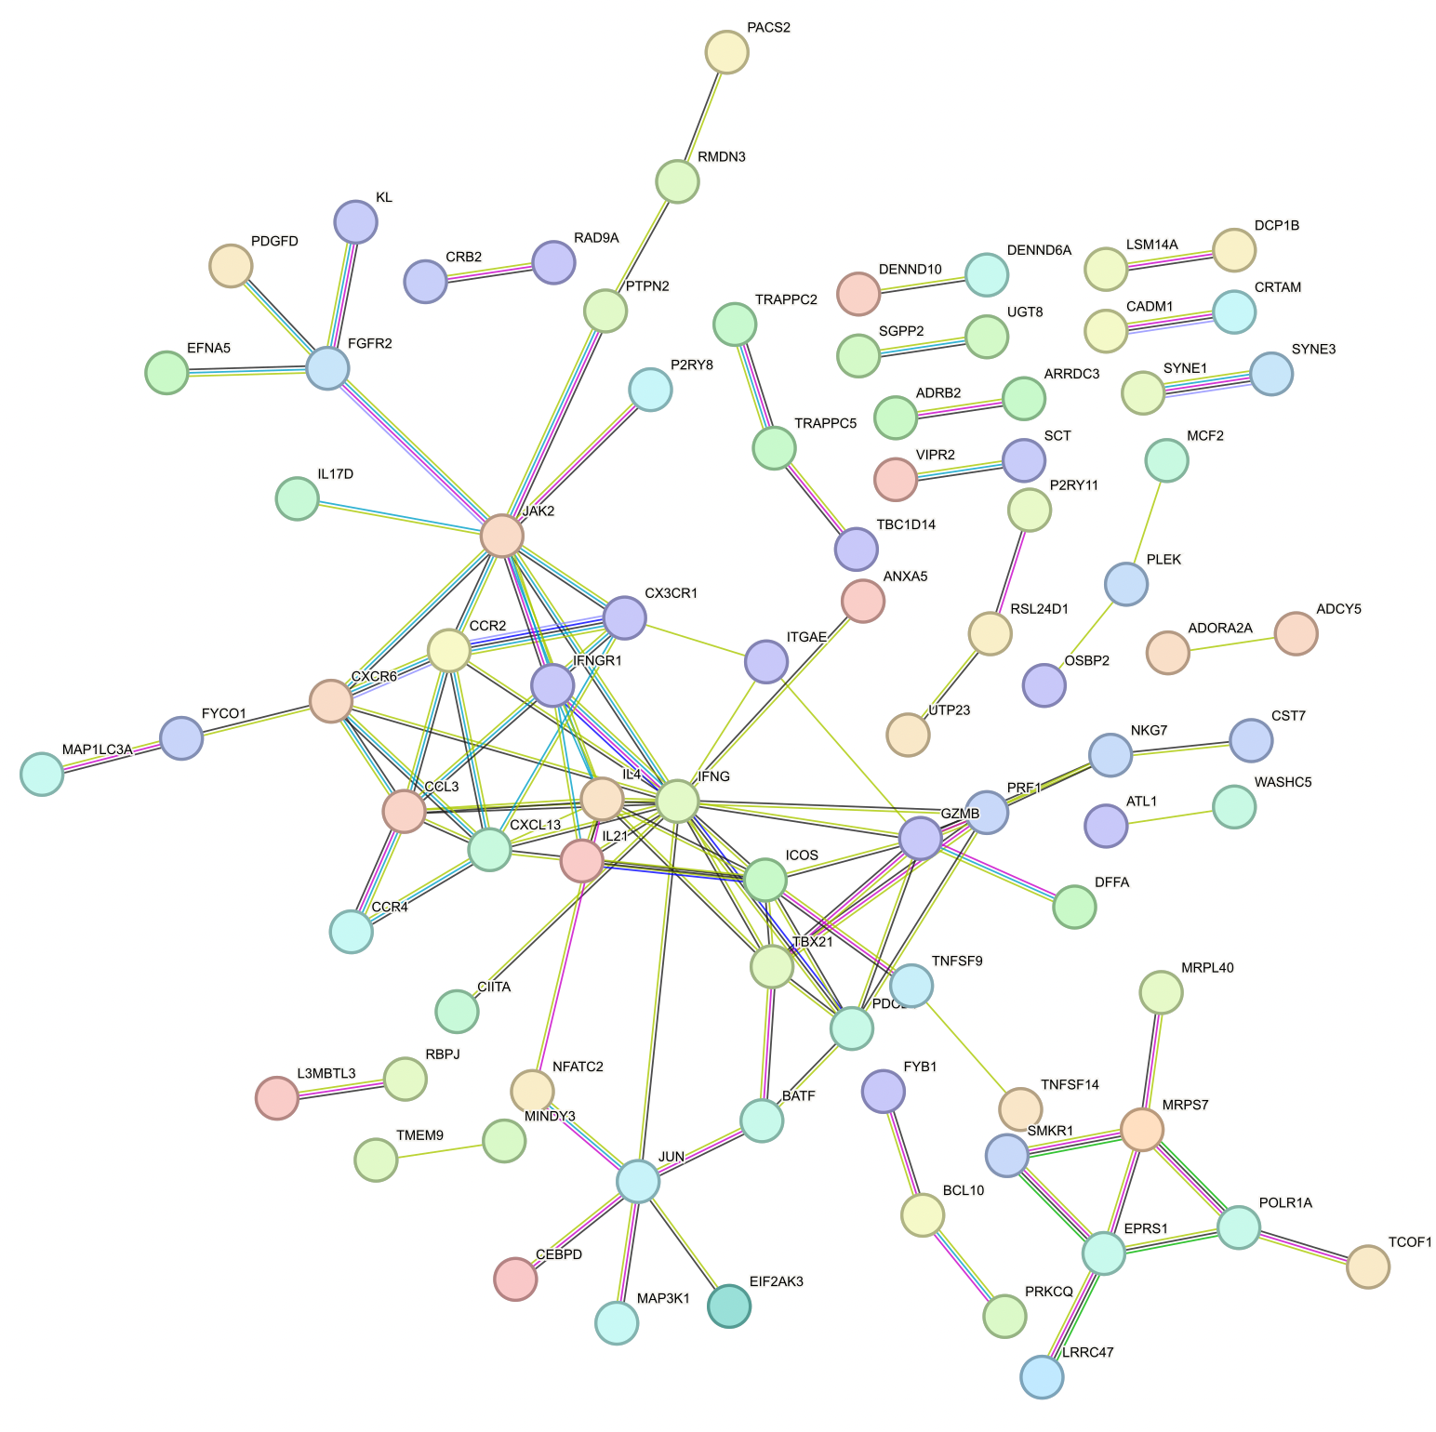
Central IFNG cluster in peaks’ genes up in DP CD127⁺ vs. DN

Slide 50

Similar PPI of peaks’ genes up in DP CD57⁺ vs. DP PD-1⁺ here as in Erin’s analyses

Slide 51

PPI of peaks’ genes up in DP PD-1⁺ vs. DP CD57⁺

Slide 52

Distinct TFs enriched in DARs in DP PD-1⁺ vs. DP CD127⁺ contrast
Notes:
Tcf7 and Lef1 up in PD-1+ consistent between Erin’s and this projects, JunB being up in CD57+ also consistent (very low pval here though)
Fosl2 up in Erin’s CD57+ vs. PD-1+… here I see it up in CD127+ vs. PD-1+… also see Lef1 up here in CD127+ vs. PD-1+

Slide 53

Distinct TFs enriched in DARs in DP CD57⁺ vs. DP CD127⁺ contrast
Notes:
Tbx21 was up in Erin’s CD57 vs. PD-1… also see it up here vs. CD127+
Also see Tcf7 here up in CD127+, as was seen up in PD-1+ vs. CD57+… (here and in Erin’s)

Slide 54



Comparison of KEGG analyses between projects
!
!
!
!
P576
P452 (Erin’s)

